Slide 1



Intensive: Building the System Backbone: Strategies to Secure FFP for Administrative and IT Investments
June 14, 2024

Slide 2
ABC’s of APDs
Eugene Gabriyelov
Deputy Director
Division of State Systems (DSS)
Data and Systems Group (DSG)

Slide 3
This session will:
Provide
Provide an overview of the MES Team’s body of work
Explain
Explain the purpose of the Advanced Planning Document (APD), types of APDs, and when an APD is needed.
Describe
Describe what should be included in an APD
Review
Review allowable activities and expenditures for planning, development, and operations.
Emphasize
Emphasize the need for collaboration between program and IT throughout the project lifecycle
Discuss
Discuss the available technical assistance (TA) from the State Officer team.

Slide 4
State Medicaid Enterprise Systems Team
What we do:
Medicaid Enterprise Systems team lives within the Data and Systems Group (DSG)
Our primary function is to provide funding for and oversight of State Medicaid IT Systems
We provide 90% Federal Financial Participation (FFP) funding for Design, Development, and Implementation (DDI) and 75% FFP for Maintenance & Operations (M&O)

Slide 5
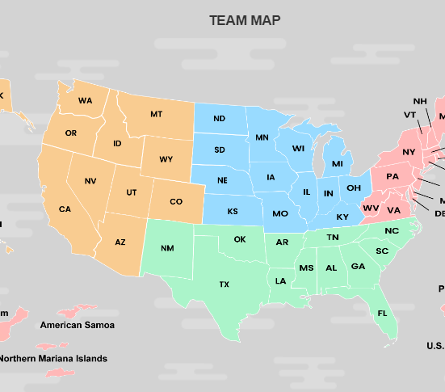
What we do
Our team is composed of over 30 State Officers who work with states day to day, and an operations team that handles non APD related work
Our funding authority comes from Title XIX of the Social Security Act
We process over 1200 (APD/RFP/Contract) submissions annually
We provide over $10 Billion in FFP to States for their Medicaid Systems each year

Slide 6
Purpose of the APD​
An APD is the primary vehicle available for states to request funding for their State Medicaid Systems.
The APD is used to:
Explain to CMS what States are looking to build and estimate how much it will cost
Describe the State’s plan for managing the development, implementation and operation of the State Medicaid system
Outline what the Medicaid agency is trying to achieve and how they will measure success

Slide 7
There are different kinds of APD’s!
Planning (PAPD)
Implementation (IAPD)
Update (APDU)
As Needed
Operations (OAPD)

Slide 8
PAPD - The Plan to Plan
Type of APD​ | SDLC Phase​ | Purpose​
Planning APD (PAPD)​ | Initiating (Planning)​ | A PAPD specifies the nature of the planning effort, including plans to investigate the feasibility, system alternatives, requirements, and resources needed to move forward with system development. Prior to initiating the Planning Phase.​ The PAPD is used to request prior approval for Federal funding to support the planning effort.
The PAPD Must Include: Statement of need, Project Management Plan for planning, Planning project budget, and Estimate of total project cost. Cost allocation | Planning activities eligible for Federal financial participation (FFP) by Federal programs include: Preparing a detailed Project Management Plan Determining system needs, Assessing project feasibility, Evaluating alternatives, Conducting cost/benefit analyses, Preparing Advance Planning Documents, Developing functional requirements, Assessing other States' systems for transfer, and Preparing procurements.

Slide 9
IAPD - Implementation
Type of APD​ | SDLC Phase​ | Purpose​
Development and Implementation | Development and Implementation | An IAPD addresses the outcome of the feasibility study, and plans for design, development, integration, testing, and deployment activities; completes the planning phase; requests prior approval of funding to conduct implementation activities. The IAPD is a culmination of the outcomes from the planning process.
HHS 45 CFR §95.610, Submission of Advance Planning Documents Rule of thumb, less is better without sacrificing Clarity. | Statement of needs and objectives; Summary of results of the requirements analysis, feasibility study, and alternatives analysis; Project Management Plan; Proposed budget; and Prospective cost allocation; Proposed activity schedule. In addition, the Implementation APD has required attachments: Cost/benefit analysis, (for each of the alternatives in the Feasibility Study of Alternatives); Budget/Expenditure detail.

Slide 10
APDU – Annual Update
Type of APD​ | SDLC Phase​ | Purpose​
Annual APD Update (APDU) | Planning or Implementation | An APDU is an update to an ongoing project and is required annually when planning or implementation activities occur for more than 1 year.
Submitted to CMS 60 days before the FFP authority for the project is set to expire. The Annual APDU includes the following sections: | References to the approved APD and all approved changes, Project status report, Revised Project Management Plan, Revised project budget, Cost allocation/distribution changes, and Actual costs Optional Acquisition Summary (prior approval exemption )

Slide 11
As Needed APD
Type of APD​ | SDLC Phase​ | Purpose​
As Needed APD Update (APDU) | Planning or Implementation | An APDU As-Needed is an update for unexpected project changes that significantly affect project costs, schedule or scope, for which the State agency is seeking approval prior to the next annual update.
As-Needed APD Updates are used to: Report and receive Federal approval for additional funding, Clarify project information requirements as an approval condition of the Planning or Implementation APD, and/or Report and receive Federal approval for significant project changes Used when the project is being funded on a phased implementation basis. | As-Needed APD Updates are submitted if changes occur in project schedule or costs which exceed the thresholds set forth in 45 CFR § 95.611(b). The As-Needed APDU may be submitted at any time, following the format of the APD being amended but including only those elements that have changed. The State must include supporting documentation to justify the need for a change to project approvals.

Slide 12
OAPD - Operations
Type of APD​ | SDLC Phase​ | Purpose​
Operational APD (OAPD) | System is fully in Maintenance and Operations​ | An OAPD is an annual report for all federally funded systems in the maintenance and operations phase, which are not operating under an open Implementation APD.​
​CMS approves M&O activities through the OAPD. Submitted Annually Brief document (usually around 2 pages) | ​Requirements: Summary of activities, Acquisitions, and Annual budget by project/systems receiving funding by programs covered under Part 95. ​

Slide 13
Key Points on Federal Funding
Federal Funding is approved ONLY through an APD.
RFP's, Contracts, and Acquisitions also require prior approval, but are separate from funding approval.
There is a 60-day clock for review once submitted to CMS.
If CMS does not request additional information (RAI) or respond within 60 days of the date of the acknowledgement letter, "the request will automatically be deemed to have provisionally met the prior approval conditions" of 45 CFR §95.611.
CMS can approve funding projections for up to two years but requires APD Update annually.
Notes:
The acknowledgment letter will identify the Federal program office that was assigned this control and provides a control number that is useful in identifying the submission in later correspondence or when inquiring as to status.
45 CFR §95.611(d) specify that HHS must provide a State written approval, disapproval, or a request for information within 60 days of the date of the acknowledgement of receipt of the State's request.
If the Federal program office does not request additional information or respond within 60 days of the date of the acknowledgement letter, "the request will automatically be deemed to have provisionally met the prior approval conditions" of 45 CFR §95.611.

Slide 14
Procurements need prior approval too…
Prior approval is required before issuing RFPs or executing any contracts or contract amendments.
Approvals for procurements are approving cost, scope, schedule and terms.
Funding for the activities within the procurement comes from the APD. Approval of the procurement is not an approval of funding to support that procurement.
Notes:
The acknowledgment letter will identify the Federal program office that was assigned this control and provides a control number that is useful in identifying the submission in later correspondence or when inquiring as to status.
45 CFR §95.611(d) specify that HHS must provide a State written approval, disapproval, or a request for information within 60 days of the date of the acknowledgement of receipt of the State's request.
If the Federal program office does not request additional information or respond within 60 days of the date of the acknowledgement letter, "the request will automatically be deemed to have provisionally met the prior approval conditions" of 45 CFR §95.611.

Slide 15
FFP is denied without prior approval
45 CFR § 95.623 provides a process by which a State may seek reconsideration of the denial of FFP related to failure to seek prior Federal approval.
If such reconsideration is needed, the State must address the following:
The acquisitions must be reasonable, useful and necessary
The State’s failure to obtain prior approval, must have been inadvertent,
The request was not previously denied by HHS
The acquisition otherwise meets all applicable Federal and State requirements
The State must not have a record of recurrent failures to seek prior Federal approval.

Slide 16
Thresholds for Prior Approval- § 95.611 Highlights
Regular FFP (50%)
A State shall obtain prior approval when the State plans to acquire ADP equipment or services with proposed FFP at the regular matching rate that it anticipates will have total acquisition costs of $5,000,000 or more in Federal and State funds.
Enhanced FFP (90% or 75%)
A State must obtain prior approval to acquire ADP equipment or services with proposed FFP at the enhanced matching rate if:
  If authorized by 42 CFR part 433, subpart C, if the contract or contract amendment is anticipated to or will exceed $500,000.
Sole Source Contracts
A State shall obtain prior approval for a sole source/non-competitive acquisition, of ADP equipment or services with a total State and Federal acquisition cost of $1,000,000 or more.

Slide 17
Some projects require cost allocation
Who benefits from the functional module?
How big is the benefit for each program?
Modules that only benefit one program should be directly charged to that program.
Notes:
Benefitting Agencies: States should provide a revised cost allocation and update to the summary of the allocation of costs by funding source, with each APD, as specified in Office of Management and Budget (OMB) Circular A-87.
The cost allocation plan must identify all participants directly benefitting from the work to be completed and their associated cost allocations.
Each Agency will review the allocation of the costs associated with the work to be completed, including design, development, and implementation activities as well as maintenance and operations activities, and determine if allocation is fair based on benefit to the Benefiting Programs.

Slide 18
  Key Reg & Sub-reg References
45 CFR Subpart F Automatic Data Processing Equipment and Services – Conditions for Federal Financial Participation (FFP) § 95.601 - 95.641
General § 95.601 – 95.605
Specific Conditions for FFP § 95.610 – 95.627
FFP in Costs of ADP (Automated Data Processing) Acquisitions § 95.631 – 95.635
SMDL 16-004 – Outlines FFP Match rates for various activities
SMDL 16-009 – Advanced Planning Document (APD) Requirements

Slide 19
Questions/Discussion

Slide 20












Consumer Direct Care Network | Direct Course | Direct Support Workforce Solutions
Guidehouse| iCareManager | Knowledge Services | Liberty| Mercer

Slide 21

Building and Financing Infrastructure for Change
Mary Brogan, Administrator Hawaii Development Disabilities Division
Mary Rapp Public Consulting Group
June 14, 2024

Slide 22
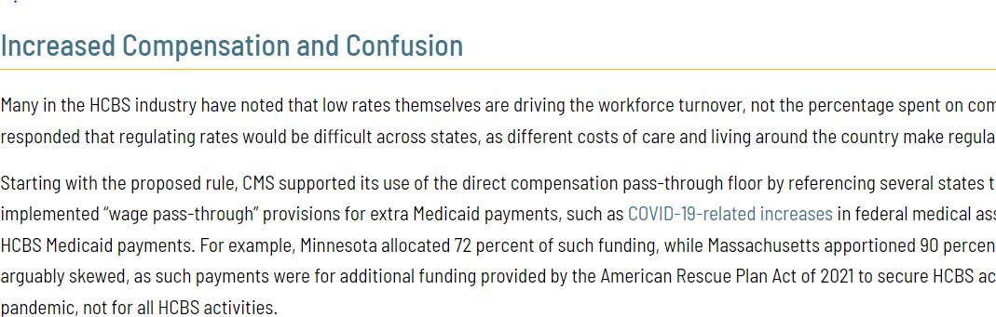
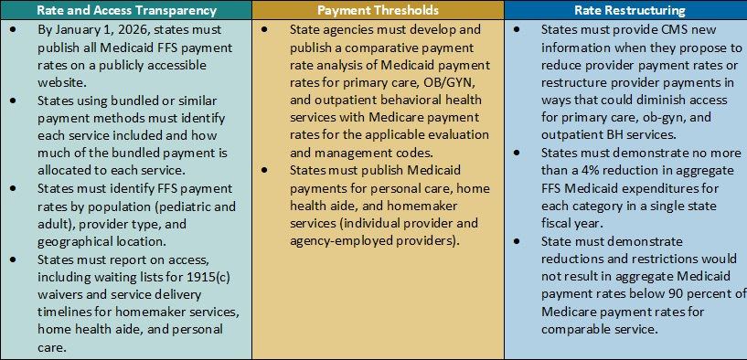
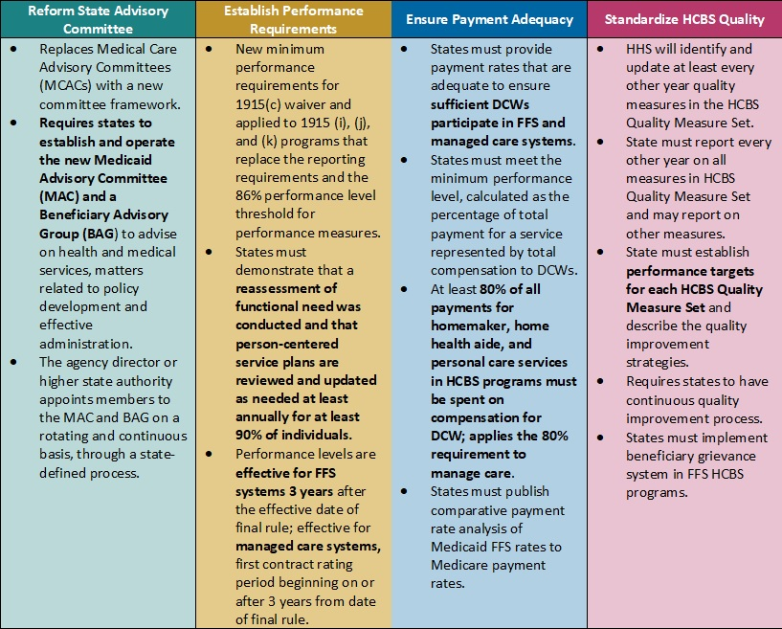
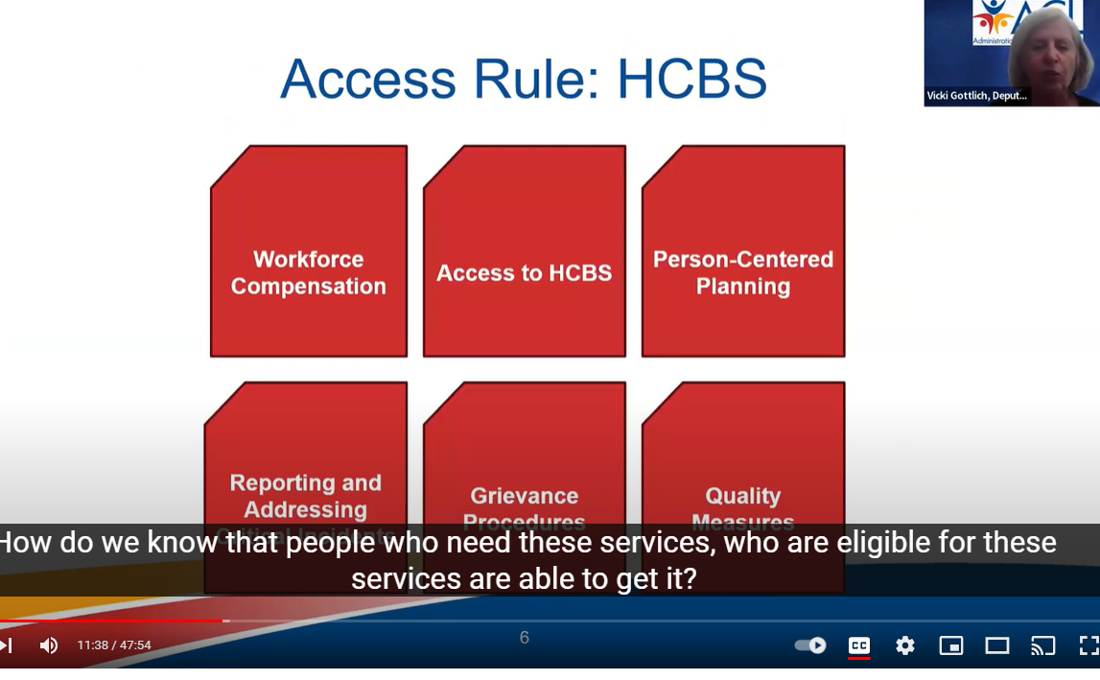
Feeling some analysis paralysis?
Notes:
Over the last few months and days, a lot of high level information has been shared.

Slide 23

Strategic Path Components
Which parts HCBS Access Rule require data- and IT- related solutions?
How will changes be financed and resourced?
What can we build on?
Notes:
As we build your strategic path to meet the various compliance deadlines, and use the Self-assessment tool, you may have started to think about which parts of the rule have implications for retooling or building your data collection or other IT-related solutions.
In the same vien, how will the changes you need to make be paid for, and what do you have in place that you can build on.

Slide 24
AGENDA
Financing Change
  Messaging strategy for general fund budget increases
    Rate increases
    Compliance
    Case Growth
    Workforce Development
  Administrative Claiming
IT System Development
Notes:
In blue, are considerations weʻre not going to directly addres in this presentation, but are probably the routine areas you are building into any request for state funds. I am anticipating needing to do focused messaging about the cost impacts of the Access Rule in short order due to Hawaii’s legislative budget cycle, and my waiver renewal.
We will focus on Admin Claiming, and IT development, and the interrelationship between these two areas.

Slide 25
Financing Change
or How to Stop Leaving Money on the Table

Slide 26
Medicaid Administrative Expenditures
Title XIX of the SSA allows states to claim federal financial participation (FFP) at a payment rate of fifty percent (50%) for most administrative expenditures related to “proper and efficient” administration of its Medicaid state plan.
Certain admin expenses at higher FFP
Costs are supported by an allocation methodology in states’ approved Public Assistance Cost Allocation Plan (PACAP).
Notes:
Higher FFP, most notably the 90/10 for DDDI, and 75/25 for M&O.

Slide 27

Show me the money!
  Hunted for/discovered our cost allocation plan in DHS
  Issued RFP to rewrite the PACAP
  Created a Department of Health-wide plan
  Established a Medicaid Administrative Claiming Special Fund through legislative process
  DOH/PCG modernized Random Moment Survey
  DOH submits claims
  Reimbursed FFP is deposited in our Special Fund
  Financed IT system build, advanced analytics, training, and some positions
Where is it?
How can I get it?
How do I claim it?
Where will I put it?
What do I want to buy?
Notes:
My story:
Started with a pre-cognitive period.
2019 Session, codified in statute
Lots went into the last three bullets, which Mary Rapp will share about.

Slide 28
Administrative Claiming Special Fund
Act 165 (Chapter 333-F-23)
Fiscal management services
Training
Quality management activities
Information technology system
Rate methodology studies
Assessments to determine level of support needs
Notes:
Defining accomplishment for Mary Brogan
Special Funds
“Revenues from public undertakings”
Legislative restrictions- Specific purposes
Reporting
Got as far as the enabling legislation

Slide 29

PCG to the rescue (4-5 slides starting with 9. These are just placeholders! )
DOH CAP
The art of claiming

Slide 30

Core Elements of Administrative Claiming
CAP
Allocap and Random Moment
Claims and partnerships

Slide 31
What We Bought and Why
A love affair with innovation, measurement and accountability in systems.
Notes:
Leader bias

Slide 32

Build, tweak, or blow up?
Hawaii at the Crossroads
Notes:
Especially applicable to IT system: no brainer

Slide 33

Hawaii’s Process Roadmap for IT System Development
Getting buy-in for INSPIRE
  What is the approval process
  Iterative Successes
  Demonstrate value
Best platform and build approach for Hawaii and why
Big Rocks:
  “Industry Trends” – the Writing on the Wall
  User Needs
  Best outcomes and system commitments
Notes:
The process:
Initially: To support Core functions within DDD
Snout to Tail
Eligibility/Intake to Case Management including ISP, Individual Supports Budgets based on SIS Levels, to Service Authorization, to Clinical and QM Review, appeals, Critical Incidents, Provider reporting, consumer portal, Grievances,
Partnership with CAMHD
Bringing in the rest of BJA.

Slide 34
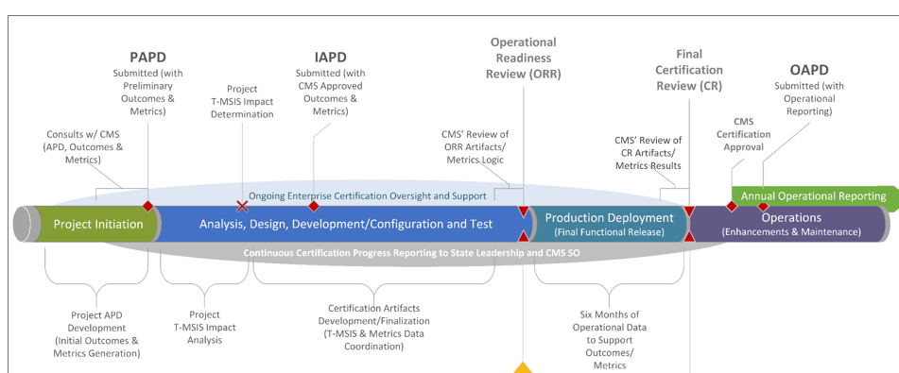
Planning
PAPD
Implementation
IAPD
Operational
OAPD
Notes:
Busy slide, which you will see again with more of the relationship with the Certification and Software Development Lifecycle, both which also have specific acronyms.
Approval/Documents Timeline: Basics
Time being a relative word
IAPD will be

Slide 35
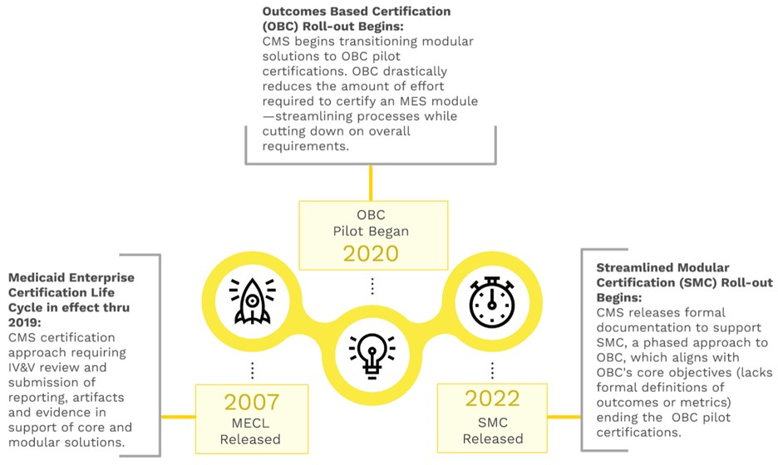
History of CMS Modular Certification
Notes:
Medicaid Enterprise Certification Lifecycle, or MECL had been the certification approach from 2007-2019, which required IV&V review and submission of required artifacts and evidence.
Outcomes Based Certification, or OBC was rolled out in 2020 as a pilot and is only used at this time for EVV modules
Streamlined Modular Certification (SMC) began in 2022 as an interim step as OBC pilots continue. This allows for state agencies to certify under a reduced amount of effort while retaining OBC core objectives.

Slide 36
What is Streamlined Modular Certification?
Modular Flexibility
Outcome Based Certification
Quantitative Analytics through Metrics
Ensures Quality and Compliance
Simplified certification process
Cost and Time Efficiency
Modular Flexibility
Data-driven policy decision making
Notes:
Streamlined Modular Certification (SMC) is a process known for its Simplified Certification approach. This process is designed to expedite the certification of individual system modules, allowing for more efficient approvals and quicker deployment.
Key Benefits of SMC
Modular Flexibility: This approach enables states to independently certify and implement Medicaid Enterprise System (MES) modules. It promotes a more agile and iterative approach to system development, allowing us to adapt and innovate more effectively.
Cost and Time Efficiency: Focusing on specific modules can reduce certification costs and timelines. This efficiency speeds up deployment and facilitates early identification and resolution of issues, minimizing disruptions.
Quality and Compliance: The Simplified Certification process ensures that each module adheres to federal standards, maintaining high quality and regulatory compliance throughout the project lifecycle.
Data-Driven Decision Making: Importantly, this process advances us into quantitative analytics. It allows State Medicaid programs to make data-driven policy decisions, assess IT investments through data trends, and continuously improve the quality of their modernized Medicaid Enterprise System modules.
With this process, we can propel our State Medicaid programs into the realm of quantitative analytics. It empowers us to make data-driven policy decisions, assess IT investments through data trends, and continuously improve the quality of our benefits. We can enhance the efficiency, flexibility, and quality of our Medicaid systems, ultimately providing better services to beneficiaries.

Slide 37
Key Elements of SMC
Streamlined Modular Certification
Conditions for Enhanced Funding
Outcomes
Metrics
CMS Required Artifacts
15 required artifacts
Some are needed for ORR and some for CR
Reported on APD
Demo during ORR and CR
Documented on APD
CMS Required
State Specific
CMS Default on GitHub
State Specific
Reported on APD
Demo during CR
Documented on Operational Report Workbook(ORW)
Compliance with CEF is shown through Evidence
CEF evidences are documented in APD
CEF evidences are demonstrated during ORR and CR as applicable
Mostly used as evidence for CEF
Notes:
The SMC is comprised of 4 key elements that States must follow to get their MES module certified and ensure continued enhanced Federal Funding during the Maintenance and Operations Phase (75% funding versus 50% if you are non-compliant with the SMC requirements)
The SMC process consists of four key elements:
Conditions for Enhanced Funding (CEFs): 22 conditions states need to comply with to secure enhanced funding—90% during the Design, Development, and Implementation (DD&I) phase and 75% during the Maintenance and Operations (M&O) phase.
It's important to note that not all conditions apply to every module. Compliance is demonstrated through the evidence for each applicable condition.
Outcomes: Outcomes serve as evidence that the CEFs are being met. They describe the measurable improvements in the MES module.
Outcomes align with program goals and state objectives. There are two types of outcomes: CMS-required and state-specific.
These are reported in the Advance Planning Document (APD) and Intake forms and presented during Operational Readiness Reviews (ORR) and Certification Reviews (CR) with CMS.
Metrics: Metrics provide evidence that the intended outcomes are achieved through new or enhanced modules.
This is the analytical component where states use data to identify trends, perform quantitative analysis, and make data-driven policy decisions.
Continuous submission of metric data to CMS enables ongoing quality improvement initiatives.
CMS Required Artifacts: There are 15 required artifacts that states must produce during ORR and CR.
These artifacts are essential for demonstrating compliance and ensuring the modules meet CMS standards.
Later in the presentation, I will provide a detailed list of these required artifacts.
By following these four elements, states can ensure their MES modules are certified and continue to receive enhanced federal funding, ultimately leading to better program outcomes and improved healthcare services.

Slide 38
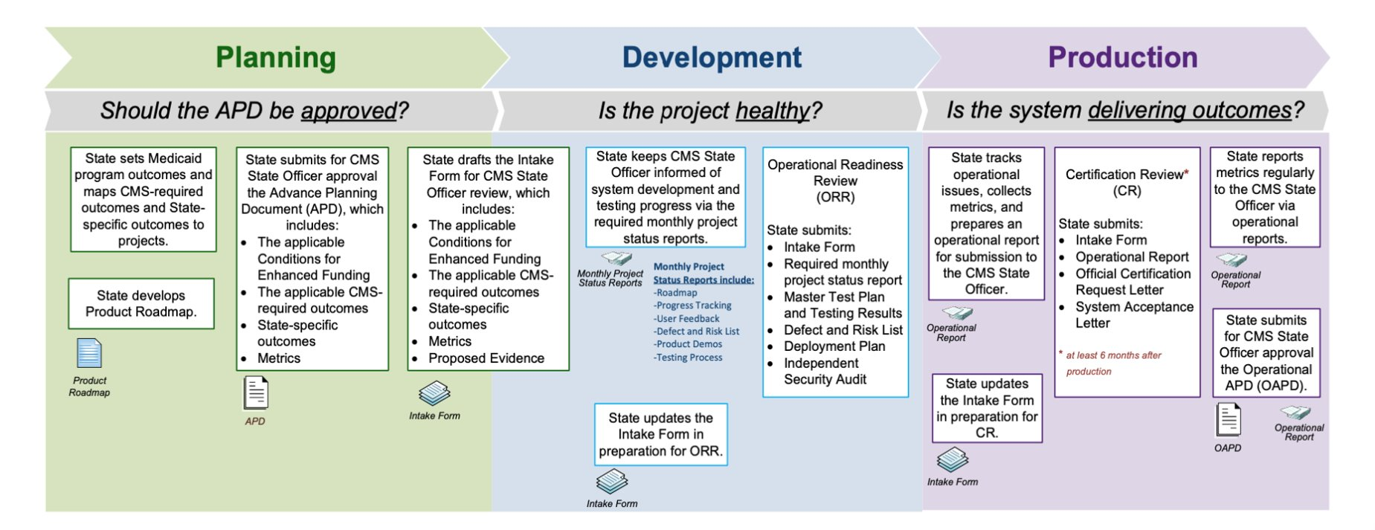
SMC Phases and Milestones
SMC Milestone 1
SMC Milestone 2
Notes:
This graphic represents the Medicaid IT Investment Lifecycle Engagement and Certification Process as outlined by the Centers for Medicare & Medicaid Services (CMS). It details the tasks that must be completed in each phase of the project to comply with Streamlined Modular Certification (SMC) requirements, ensure timely Milestone Reviews, achieve certified status and secure enhanced funding during the Design, Development, and Implementation (DD&I) and Maintenance and Operations (M&O) phases.
Each phase includes a specific number of artifacts that States are required to submit to CMS.
I will highlight a few artifacts. In the planning phase, we must start working on outcomes, metrics, and applicable CEFs that we will document in our APD.
When we enter the development Phase, we send CMS a Monthly Status report to keep them informed of the project’s health.
There are two SMC milestones: Operational Readiness Review (ORR) and Certification Review (CR). These Milestones are scheduled with CMS, and each MR requires a set of required artifacts that States must submit before they can schedule an MR with CMS.
ORR is scheduled at least one month before the Go-Live date, and CR is conducted at least 6 months post-production.
States must collect and submit six months of operational data/metrics before they can be eligible for scheduling a CR with CMS.
For States to secure 75% enhanced federal funding during M&O, they must show continued compliance by submitting the Operational Report Workbook (ORW) annually with their OAPD.

Slide 39
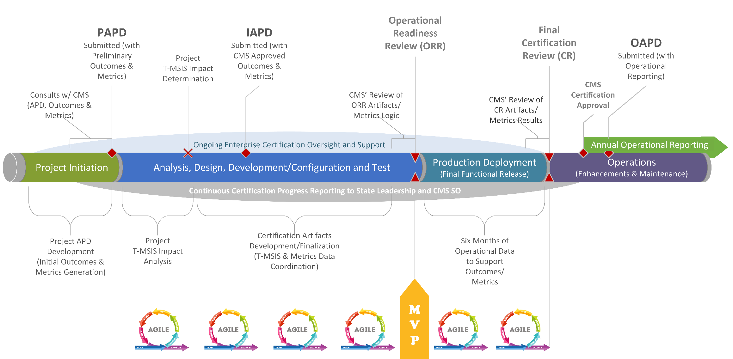
Integrating SMC Milestone Tasks into the Software Development Life Cycle (SDLC)
Notes:
This graphic illustrates another way to represent the Streamlined Modular Certification (SMC) process, aligning it with the Software Development Life Cycle (SDLC).
If your project follows an iterative framework such as Agile methodology, it is crucial to identify when your Minimum Viable Product (MVP) will be ready.
The MVP marks the point when the system achieves its minimal desired functionality. This timing is critical as it will determine the schedule for your Operational Readiness Review (ORR) and Certification Review (CR).
Scheduling ORR: You will schedule your ORR with CMS when your MVP is ready for demonstration. This review ensures that the MVP meets the necessary standards and functionality before full deployment.
Post-Deployment Data Collection: After deploying the MVP, you must collect six months of operational data. This data collection period is essential to become eligible for requesting the Certification Review (CR) with CMS.
CR Timing: You may extend the period beyond six months post-production to optimize the system. During this optimization phase, your metric data might be skewed due to various data collection reasons.
By following this process, you ensure that your project remains aligned with both Agile practices and SMC requirements, ultimately facilitating a smoother certification process and ensuring ongoing compliance.

Slide 40
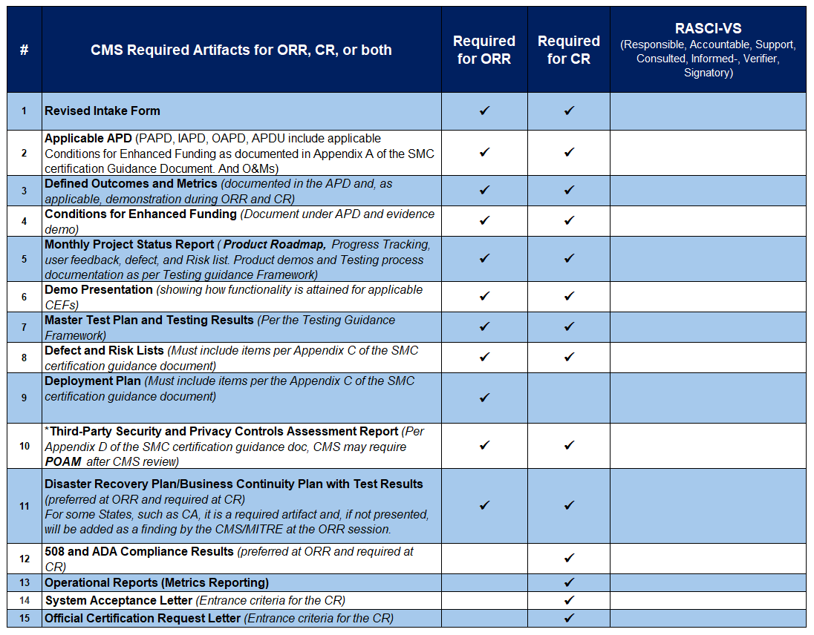
SMC
Required Artifacts
Notes:
This slide lists the CMS-required artifacts necessary to comply with the Streamlined Modular Certification (SMC) requirements. It's important to note that some artifacts are needed for both the Operational Readiness Review (ORR) and Certification Review (CR), while others are only required for the CR.
I want to emphasize that the third-party security and assessment report is the most critical artifact. This report often takes the longest to produce and can be challenging for projects to complete on time.
Ensuring the security of our Medicaid Enterprise System (MES) module is crucial for protecting our Medicaid members. It is our responsibility to design a system that complies with all HIPAA privacy regulations and safeguards the personally identifiable information (PII) and protected health information (PHI) of Medicaid members.
By prioritizing these security measures, we can ensure that our system not only meets federal requirements but also provides robust protection for our members' sensitive information.

Slide 41





Unlocking SMC Success:
The Power of Collaboration, Coordination, and Communication Across Vendor and State Teams
HI Team
RSM
PCG
CMS Certified
INSPIRE
Notes:
The key to a successful Streamlined Modular Certification lies in effective coordination, open communication, and collaboration among all external and internal stakeholders.
Given that these projects are executed in a multi-vendor environment, it is crucial to foster a productive atmosphere where everyone works together as a cohesive team. This unified approach is essential for improving the lives of Medicaid beneficiaries.
By ensuring seamless coordination and maintaining transparent and open lines of communication, we can overcome the complexities of a multi-vendor setting. Collaboration among stakeholders ensures that every aspect of the project aligns with our shared goal of enhancing Medicaid services.
Ultimately, the success of our efforts depends on our ability to work together harmoniously, leveraging each other's strengths and expertise to achieve the best outcomes for Medicaid beneficiaries.

Slide 42
Acronyms
SMC | Streamlined Modular Certification
ORR | Operational Readiness Review
CR | Certification Review
MR | Milestone Review
MVP | Minimal Viable Product
O&M | Outcomes and Metrics
CMS | Center for Medicaid Services
SMDL | State Medicaid Director Letter
APD | Advance Planning Document
FFP | Federal Financial Participation
DD&I | Design Development and Implementation
M&O | Maintenance and Operations
MES | Medicaid Enterprise System
RASCI-VS | Responsible Accountable Support Consult Informed-Verified signatory
ORW | Operational Report Workbook
Notes:
Here is the list of acronyms used in this slide

Slide 43
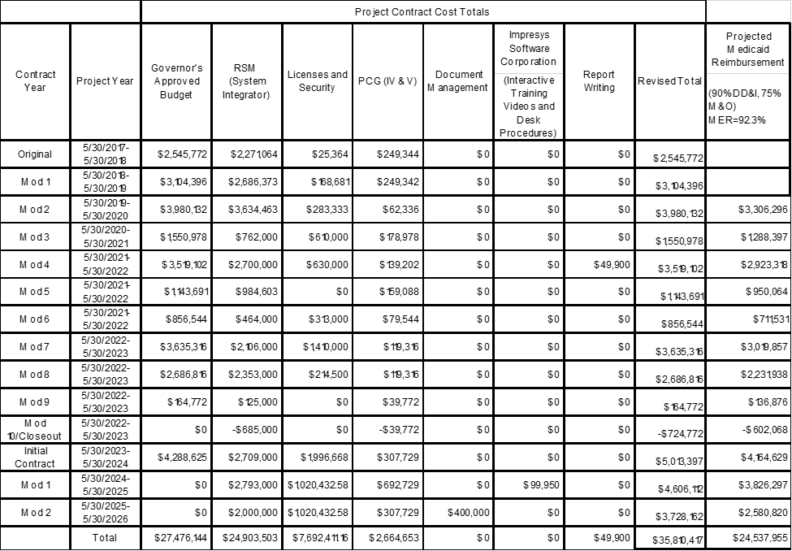
Financing Results for INSPIRE
Claiming results
Better positioned to refine, add, tweak.
Next magic act: Analytics, Reporting, and Using the Data- a foray into wisdom

Slide 44
Six years later
Consistent rehearsal
  Strengthen your familiarity
Refine delivery style
  Pacing, tone, and emphasis
Timing and transitions
  Aim for seamless, professional delivery
Practice audience
  Enlist colleagues to listen & provide feedback
Seek feedback
Reflect on performance
Explore new techniques
Set personal goals
Iterate and adapt

Slide 45
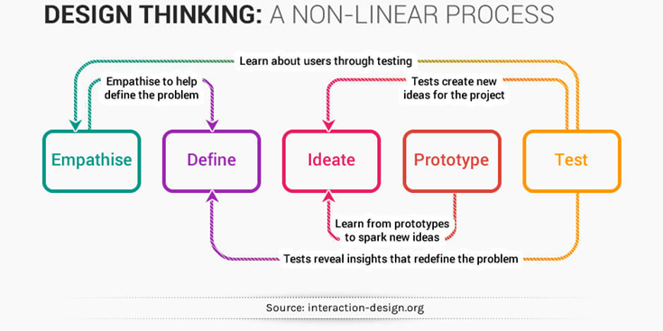
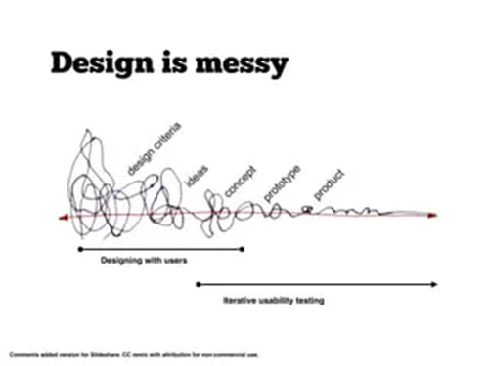

Slide 46
Thank you
Mary Brogan
mary.brogan@doh.hawaii.gov
https://health.hawaii.gov/ddd/

Slide 47

Join us for the
NASDDDS 2024 Directors Forum
and Annual Conference
Salt Lake City, Utah
November 19 | Directors Forum
November 20-22 | Annual Conference
Call for sessions & registration opens
in August!

