Slide 1



Intensive: The New HCBS Quality Paradigm: Positioning for CQI and Enhanced Health and Welfare Expectations
June 14, 2024

Slide 2












Consumer Direct Care Network | Direct Course | Direct Support Workforce Solutions
Guidehouse| iCareManager | Knowledge Services | Liberty| Mercer

Slide 3
Agenda

Slide 4

Agenda
8:30 am – Welcome, Introductions, Agenda
8:45 am – Pennsylvania/Mercer, Incentivizing Quality
9:35 am – Access Rule Overview – Quality
9:45 am – NCI & Access Rule Quality
10:05 am – Group Work
10:40 am – Break
11:00 am – Table Report Out
11:50 am – Wrap-Up/Discussion
12:30 am – Thank You & Safe Travels!

Slide 5
Performance-Based Contracting to Improve Quality

Slide 6



Performance-Based Contracting to Improve Quality
Commonwealth of Pennsylvania, Office of Developmental Programs
welcome to brighter
June 14, 2024
Kristin Ahrens, Misti Beckman, Beth Lewis, Teja Stokes
A business of Marsh McLennan

Slide 7



Design Overview
Residential Provider Standards and Financial Tools
Performance Standards to Improve Quality
Agenda

Slide 8
Design Overview

Slide 9
Improve Quality
What Problem(s) Needs Solving?
Challenges
Inadequate Management Tools
LifeCourse in Complex Systems Navigation
Payment Structure Not Outcome Aligned
Poorly Performing Providers and Insufficient Capacity
Increasing Acuity of Assessed Needs

Slide 10
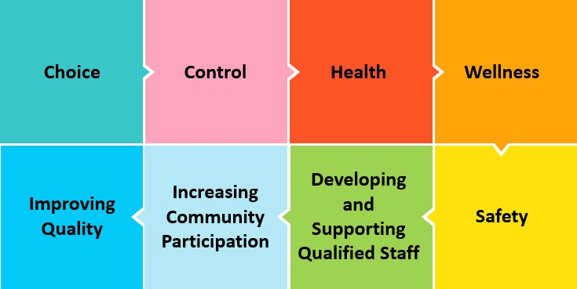
Performance-Based Contracting Goals
Uphold values of Everyday Lives
Ensure program:
  Sustainability
  Access
  Workforce
  Clinical capacity

Slide 11
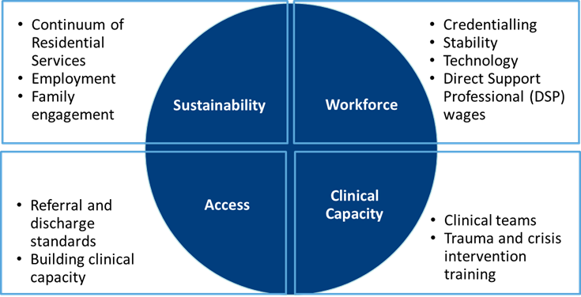
Performance Standards Areas
Performance standards for residential providers align with ODP’s goals for sustainability, access, workforce, and clinical capacity.
Performance standard areas include metrics that connect to areas in the recently finalized Access Rule.
Supports DEI efforts to improve equity of the workforce.

Slide 12



Stakeholder Engagement
Concept Paper and Public Comment
June 2023
Waiver Application Public Input Process
April 2024
ISAC Meeting
April 2023
Residential Strategic Thinking Group
June 2023 to October 2023
Implementation
January 2025

Slide 13


Stakeholder Feedback Process

Slide 14
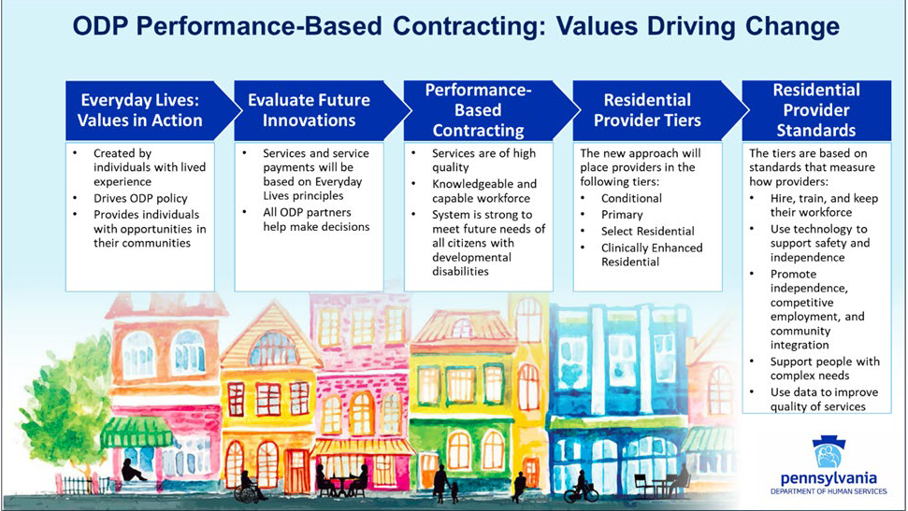
5/31/2024
9

Slide 15
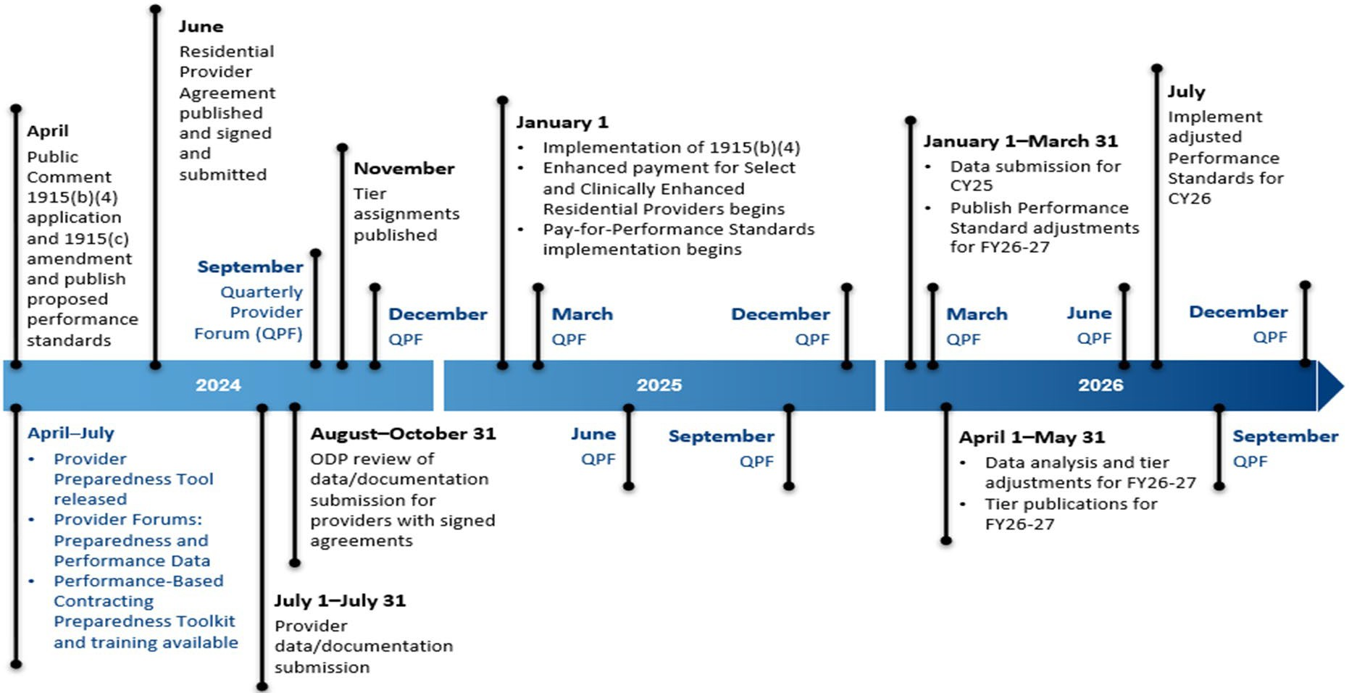
Performance-Based Contracting Implementation Timeline
10

Slide 16
Residential Provider Standards and Financial Tools

Slide 17
Residential Provider Tiers
Clinically Enhanced Residential
Select Residential
Conditional
Primary
Providers operating under provisional or revoked licenses
Providers that meet current standards and a few additional standards
Providers that deliver at least two of the three residential services in the performance- based contracting model and meet the established enhanced measures
Providers that offer Clinically Enhanced medical or behavioral supports and meet the established enhanced measures

Slide 18




Residential Provider Standards
Hire, train, and keep workforce
Use technology to support safety and independence
Tiers based
on standards
that measure
how
providers perform
Promote independence, competitive employment, and community integration
Support people with complex needs
Use data to improve quality

Slide 19



Residential P4P Modeling
Guiding Principles for Program Design
Simplicity
Leverage existing metrics
Limit administrative burden
Maximize stakeholder comprehension and cooperation
Uniformity
Measure incentives
Benchmarking
Improvement goals
Achievement goals
Accessibility
All providers* able to earn some P4P milestone payments
Achievable improvement goals by provider category
Attainable for primary providers
*Not including Conditional providers

Slide 20
P4P Example Cycle
Ongoing Review and Update
P4P 3-year data review
Introduce additional requirements/ benchmarks
System-Wide Milestone Payments
Phase 2 P4P payments
Tiered benchmarks
Provider-Specific Milestone Payments
Capacity building
Phase 1 P4P payments
Pay-for-Reporting
Data reporting/collection
Capacity building

Slide 21
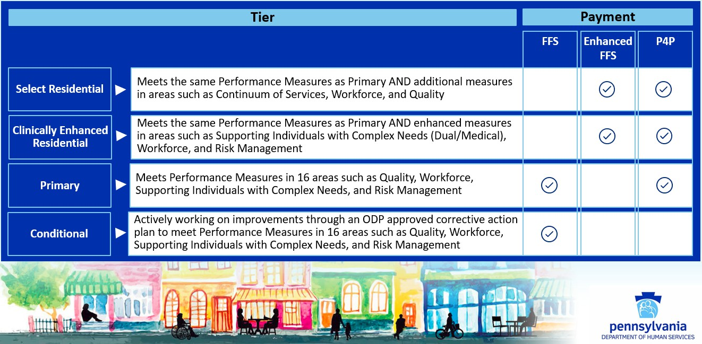
Performance-Based Contracting Financial Tools

Slide 22
Performance Standards to Improve Quality

Slide 23

New Focus on Outcomes
Shifting focus in HCBS systems
Federal Access Rule: CMS HCBS Quality Measure Set
Pennsylvania ODP: Performance-Based Contracting

Slide 24
Plan for Achieving Outcomes
Identify Performance Areas
Individual Outcomes
Systems Outcomes
Collect, Analyze, and Use Data
Establish Measures
Data Informs Policy and Practice
Develop Common Understanding of Performance Standards
Provider Level Data
Population and Systems Level Data
Establish Benchmarks and Performance Targets
Evaluate and Adjust Performance Targets (CQI)

Slide 25

Performance-Based Contracting Residential Measure Features
Measures designed to work together
Clinical Capacity
New standards related provider clinical capacity
Data use to impact individual outcomes (example: Restraint, Inpatient Care)
Access
Community integration
Competitive Integrated Employment
Referral/discharge standards

Slide 26
Performance-Based Contracting Residential Measure Features
Performance targets for established policy
  Incident management and health risk screen fidelity
  QM Plan
  Competitive Integrated Employment
Performance targets to build capacity and continuous quality improvement framework
  Credentialing
  New training requirements
  Outcomes

Slide 27
Performance Standards
Performance Area | Developing Outcome Area
Supporting Individuals with Complex Needs | Demonstrate use of data to impact individual outcomes (review to include all these elements: law enforcement, restrictive procedures, inpatient, restraint, confirmed abuse/neglect, polypharmacy, target behavioral data, individuals’ satisfaction with services) Track and use data from the Health Risk Screening Tool measure interruption in daily activity because of illness (“clinical status”) to improve health outcomes
Community Integration | Demonstrate that individuals are engaged in meaningful activities, as defined by the individual, outside of their home based on their strengths, interests, and preferences
Family Engagement | Family satisfaction with provider engagement
Referral and Discharge | Timeliness of service initiation in Community Homes Referral review process Discharge practices

Slide 28
Phasing in Performance Standards
Many performance measures reflect current requirements (incident management, health risk screening, behavioral support, follow-up post hospitalization, employment)
  No change in many areas for primary providers
  Some measures include new reporting requirements for primary providers (for example, employment)
  Select and Clinically Enhanced providers typically have performance targets they must meet to qualify for that tier
New performance areas that begin January 1, 2025, rely heavily on attestations, demonstration of data use, and reporting requirements for first contract cycle (January 1, 2025–June 30, 2026)
  Generally aimed at capacity building and have value-based payment opportunities through P4P and enhanced rates to support providers with implementation (for example, credentialing, use of remote technology)
Reporting requirements in first contract cycle will support development of performance targets for contract cycles beginning in FY26–27 and FY27–28

Slide 29
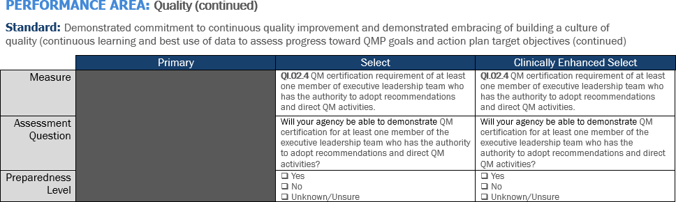
Residential Provider Performance-Based Contracting Preparedness Assessment
ODP will publish provider preparedness tools and hold provider forums to support providers as they get ready for performance-based contracting implementation by July 1, 2024
Provider preparedness tools include:
  Residential Provider Performance-Based Contracting Preparedness Assessment
  Assessment includes a template to support providers developing plans to improve performance on the standards ahead of implementation in January 2025
ODP will also hold provider preparedness forums for detailed review of measures

Slide 30
A business of Marsh McLennan
Copyright © 2024 Mercer (US) LLC. All rights reserved.

Slide 31
ACCESS Rule Overview

Slide 32

Critical Incidents

Slide 33
New Assurance
Assurance that the state operates and maintains an incident management system that identifies, reports, triages, investigates, resolves, tracks, and trends critical incidents.
Effective Date — 3 years (July 9, 2027).

Slide 34
New Definition
Defines critical incident to include, at a minimum —
Verbal, physical, sexual, psychological, or emotional abuse;
Neglect;
Exploitation including financial exploitation;
Misuse or unauthorized use of restrictive interventions or seclusion;
A medication error resulting in a telephone call to or a consultation with a poison control center, an emergency department visit, an urgent care visit, a hospitalization, or death; or
An unexplained or unanticipated death, including but not limited to a death caused by abuse or neglect.
Effective Date — 3 years (July 9, 2027).

Slide 35
New Information System
Enables electronic critical incident data collection.
Tracking (including of the status and resolution of investigations).
Trending.
Effective Date — 5 years (July 9, 2029).

Slide 36
New Reporting Requirements
The state must report, every 24 months, on the results of an incident management system assessment to demonstrate that it meets the requirements.
  - CMS may reduce the frequency of reporting to up to once every 60 months for states with incident management systems that are determined by CMS to meet the requirements.

Slide 37
New Identification Requirements (1 of 3)
The state must: ​
Require providers to report to the state, within state-established timeframes and procedures, any critical incident that occurs during the delivery of services authorized under section 1915(c) of the Act and as specified in the waiver participant's person-centered service plan, or occurs as a result of the failure to deliver services authorized under section 1915(c) of the Act and as specified in the waiver participant's person-centered service plan. ​
Use claims data, Medicaid fraud control unit data, and data from other state agencies such as Adult Protective Services or Child Protective Services to the extent permissible under applicable state law to identify critical incidents that are unreported by providers and occur during the delivery of services authorized under section 1915(c) of the Act and as specified in the waiver participant's person-centered service plan, or occur as a result of the failure to deliver services authorized under section 1915(c) of the Act and as specified in the waiver participant's person-centered service plan. ​

Slide 38
New Identification Requirements (2 of 3)
Ensure that there is information sharing on the status and resolution of investigations, such as through the use of information sharing agreements, between the state and the entity or entities responsible in the state for investigating critical incidents.

Slide 39
New Identification Requirements (3 of 3)
The state must:
Initiate an investigation, within state-specified timeframes, for no less than 90 percent of critical incidents;
Complete an investigation and determine the resolution of the investigation, within state-specified timeframes, for no less than 90 percent of critical incidents; and
Ensure that corrective action has been completed within state-specified timeframes, for no less than 90 percent of critical incidents that require corrective action.
Separately investigate critical incidents if the investigative agency fails to report the resolution of an investigation within state-specified timeframes ("intended to ensure that the failure to effectively share information between state agencies or other entities in the state responsible for investigating incidents does not impede a state's ability to effectively identify, report, triage, investigate, resolve, track, and trend critical incident").
Effective Date — 3 years (July 9, 2027)

Slide 40
Quality Measure Set
Notes:
Laura

Slide 41
HCBS Quality Measure Set: Background
September 2020
  RFI seeking feedback on a draft set of recommended HCBS measures
July 21, 2022 - SMDL 22-003 released
May 3, 2023 – July 2, 2023
  Access NRPM
January 25, 2024 - CMS outlines requirement for MFP Grantees
April 11, 2024 - Informational Bulletins
2024 Home and Community-Based Services (HCBS) Quality Measure Set (QMS)
Home and Community-Based Services (HCBS) Quality Measure Set (QMS) Reporting Requirements for Money Follows the Person (MFP) Demonstration Grant Recipients
April 11, 2024 - LTSS Quality Measures Technical Specifications and Resources Manual
April 2024 - Final Access Rule
Notes:
Laura
Start with timeline – talk about final access rule. And then move into MFP requirements
September 2020:
CMS released a request for information (RFI) seeking feedback on a draft set of recommended HCBS measures
ADvancing States submitted written feedback
Measures were described as voluntary and organized by NQF domain
SMDL 22-003 1st of 2 guidance documents from CMS
Intended for use in all HCBS programs
Intended to apply to both FFS and managed care

Slide 42
Access Rule and Quality Measure Set Goals
The set of nationally standardized quality measures for Medicaid-funded HCBS is intended to:
Promote more common and consistent use within and across states of nationally standardized quality measures in HCBS programs;
Create opportunities for states and CMS to have comparative quality data on HCBS programs;
Drive improvement in quality of care and outcomes for people receiving HCBS; and
Support states’ efforts to promote equity in their HCBS programs.
Notes:
Rosa
Acknowledge that measure set is a big lift for states, but the goal is important –
it's not just compliance that we want to help states with
but also the actual measurement of quality in the hopes of creating systems that support people to live the lives that they desire, with equity

Slide 43
Background: Access Rule and Quality Measure Set
Source
Vast majority of measures are drawn from surveys of people with lived experience
Flexibility
CMS permits states flexibility to determine which survey tool they implement (from the following):
    NCI®-IDD
    NCI-AD™
    HCBS CAHPS®
    POM®
The measure set also includes other nationally standardized and tested measures related to key areas, such as access, LTSS rebalancing, community integration, health and safety, and person-centered practices.
Notes:
Rosa
The HCBS Quality Measure Set has two requirements – administrative measures which are outlined in the Long-Term Services and Supports (LTSS) Quality Measures Resources Manual, released in April and the Experience of Care Surveys
For the EoC survyes requirement you can choose from the list on the slide - Home grown” surveys will not meet the requirement

Slide 44
Access Rule Quality Section Overview
Requires adoption of HCBS Quality Measure Set
  Originally shared as guidance in SMD Letter #22-003
  Applies to all HCBS authorities (except state plan personal care) and all delivery systems, as well as self-directed programs
  Requires reporting stratification phase-in
The state must establish performance targets, approved by CMS, for each measure in the HCBS Quality Measure Set that are identified as mandatory, and describe the state’s quality improvement (QI) strategies they will pursue to achieve performance of those measures.
Notes:
Presenter: Laura
Talking Point(s):
First we're going to look at an overview
Recap back to Measure set – its been a minute since we looked at that in depth
Then look at a few more areas in the NPRM, specifically time period and stratification reqs

Slide 45
Access Rule
Reporting on the HCBS Quality Measure Set
Replace the minimum 86% performance level for states performance measures described in 2014 guidance
States report every other year on all measures in the HCBS Quality Measure Set that are identified by the Secretary (following phased in approach)
CMS will report on a subset of the measures on behalf of states
Notes:
Presenter: Laura

Slide 46
Stratified Data
Stratification would allow CMS and states to identify health and quality of life outcomes, and differences in outcomes
  Identifies subset of measures to be stratified by race, ethnicity, sex (biological), age, rural/urban status, disability, language, or other factors.
CMS "recognizes challenges to stratification;" phased-in approach:
  Provide stratified data for 25% of measures by 4 years after effective date
  50% of measures by 6 years
  100% of measures by 8 years
Notes:
Presenter: Rosa
Talking Point(s):
In terms of stratification, very few changed were made in the final regulation from what we saw in the NPRM,
except stratification based on tribal status was removed because it does not align with data elements in the core set
States will, over time, be required to
Identify subset of measures to be stratified by race, ethnicity, sex (currently defined as biological), age, rural/urban status, disability, language, or other factors to be identified in the measure set
As you can see on the slide, 25% will be required within 4 years, 50% within 6 years, and 100% within 8 years
Pushed out the implementation by a single year so that 4 years instead of 3...

Slide 47
MFP Grantee States and Territories –
HCBS Quality Measure Set Implementation
MFP grant recipients are required to report in Fall 2026 on the HCBS Quality Measure Set every other year for their section 1915(c), (i), (j), and (k) programs and section 1115 demonstrations that include HCBS.
  For the initial implementation of the measure set, MFP grant recipients can opt to, but are not required to, stratify data for MFP participants and by demographic or other characteristics of their HCBS participants.
Notes:
Laura mentioned that the Access Rule requires implementation of the HCBS quality measure set, but Money Follows the Person (MFP) grantee states are required to implement on a much quicker timeline
MFP grantees will need to report in Fall 2026 for the 1915 c, I, k, K and 1115 demonstrations that include HCBS – not just MFP populations.
All authorities except 1905 state plan
CMS has framed the MFP implementation as a "Glidepath" to compliance with the Access Rule

Slide 48
National Core Indicators®-IDD

Slide 49


NCI-IDD in the HCBS Quality Measure Set:
Reporting Standardized Data on Quality
“The Access Rule is the most consequential, comprehensive regulation related to Medicaid-funded HCBS in a decade. It will strengthen the HCBS that make it possible for people to live in their own homes, stay connected to friends and family, and participate in the community in ways that are meaningful to them.”
Alison Barkoff, Performing the duties of ACL Administrator and Assistant Secretary of Aging

Slide 50
Access Rule and Quality Measure Set
Data Sources
Populations
All populations served by HCBS
Flexibility
CMS permits states flexibility to determine which survey tool(s) they implement in order to capture quality measures from the population receiving HCBS (from the following):
    NCI®-IDD
    NCI-AD™
    HCBS CAHPS®
    POM®
Notes:
Home grown” surveys will not meet the requirement

Slide 51
Access Rule and Quality Measure Set Background
Multiple measures for each ‘topic’ so that:
  a state doing the NCI-IDD® survey would only use the applicable NCI-IDD Quality measures to report outcomes for adults receiving services through the state DD System
  a state doing the NCI-AD™ survey would only use the applicable NCI-AD Quality measures to report outcomes for older adult and persons with physical disabilities
  To report the specific measures included in the measure set, states must administer the entire NCI surveys (can’t pull out measures).
Notes:
with the inclusion of all populations and authorities in NPRM its possible states would need to utilize multiple surveys

Slide 52

MFP Grantee States and Territories –
HCBS Quality Measure Set Implementation
First year of reporting will be 2026, using performance data from 2025
For NCI participating states, data reported would be from 2024-2025 survey cycle
For the initial implementation of the HCBS Quality Measure Set, MFP grant recipients will be expected to report on a subset of the measures in the measure set (yet to be determined) and to develop a quality improvement plan related to two measures of their choice

Slide 53
Access Rule and Quality Measure Set Background
States that are already administering
NCI are well positioned to meet
MFP and Access Rule reporting requirements
Many states are only surveying some waiver populations, not all, so additional work will be needed
Equity stratification will be a big lift, but there is time!
Chances are, your state has some experience with NCI……
Notes:
- thankful for feedback from states, both through meetings and through measure steward TA work
- feedback provided to CMS through comments to NPRM - especially around timeline and stratification
- a state piloted measure set and we were able to provide feedback based on their experience

Slide 54

National Core Indicators®-
State Participation
Has participated in NCI-IDD and NCI-AD in past
WA
NH
ME
VT
MT
ND
MA
Has participated in NCI-IDD in past
OR
MN
NY
ID
SD
WI
MI
RI
WY
PA
CT
IA
NJ
NE
OH
DE
Has not participated in NCI
NV
IL
IN
MD
UT
WV
VA
CA
CO
KS
MO
KY
DC
NC
OK
TN
AZ
NM
AR
SC
MS
AL
GA
TX
LA
AK
FL
HI

Slide 55
Remember The “Why.….”
The HCBS Quality Measure Set is intended to
Promote more common and consistent use within and across states of nationally standardized quality measures in HCBS programs
Drive improvement in quality of care and outcomes for people receiving HCBS
Support states’ efforts to promote equity in their HCBS programs
Reduce burden of trying to identify and use HCBS quality measures
This is good and important work, and the NCI team is excited to be by your side throughout the process….

Slide 56
NCI-IDD Measures
All included NCI-IDD measures are categorized into domains and subdomains
  Subdomains reflect individual and systemic outcomes that are important to consider when measuring system performance and quality.
  NCI-IDD measures have been identified to directly address person-centered planning and person-centered practices.

Slide 57
NCI-IDD Measures
CMS has chosen 16 important specific measures from the NCI-IDD IPS survey to include in the HCBS Quality measure set
  Survey must be done in its entirety to gather the data for the CMS HCBS quality measure set.
IPS in its entirety supports states to see a comprehensive picture of the status and outcomes of the population receiving services.

Slide 58

NCI-IDD In-Person Survey (IPS) Administration
Target population: Adults receiving at least one HCBS in addition to case management from the state DD system. Sampling: Random sample with a 95% confidence level and 5% margin of error based on sample frame. Surveyor training: All surveyors complete standardized training. States have the option to use peer-surveyors as well. Timeline: Survey runs from July 1–June 30. For data submission by Sep 2026, data collection should start in the 2024–25 survey cycle. Survey features: Validated and tested with continuing maintenance May be conducted in-person or remotely, via videoconference Includes a detailed background information section that primarily comes from existing records Available in multiple languages Questions may be rephrased or reworded Allows for use of proxy for select questions Survey administration is also person -centered– questions may be rephrased or reworded, language accommodations as well States may also add supplemental questions

Slide 59
Why is it important to have a standardized way to report quality?
To examine quality, you can see where your state fits compared to other states and know that other states measured the indicator in the same way.
2022-23 data—preliminary

Slide 60
NCI Allows You To Do Breakdowns
“…race, ethnicity, Tribal status, sex, age, rural/urban status, disability, language, or such other factors as may be specified by the Secretary”
2022-23 data—preliminary

Slide 61
With NCI, You Can Do Other Breakouts Potentially Required by Access Rule
2022-23 data—preliminary

Slide 62
Breakouts as requested by the Access Rule

Slide 63
Things to note:
Metro/Micro higher rates of having had hearing test within the past 5 years
Look at the Don’t Know—Yellow Bar. Lots of work to find a reliable source of these data within state records

Slide 64
How Can The Data Reported To CMS Help The State Examine Quality?
Identify racial and ethnic disparities (e.g., decision making, social connections, etc.)
Convene racial diverse focus groups to explore roots of disparities
With racially diverse advisors, develop policies aimed at reducing/removing disparities
Establish improvement benchmarks
Collect data to assess the success of initiatives
Explore potential issues re: access to preventive health services
Review regulations to determine whether yearly preventive screening (pap smears, hearing tests, etc.) are required in residential settings
Work with family groups to prioritize getting access to health screenings for family members
Conduct public information campaigns re: importance of health screenings
Measure results
Address the lack of available transportation
Meet with state and regional transportation officials
Identify the living situations of those most likely affected by transportation issues
Assess whether HCBS waivers include adequate transportation and whether fees are sufficient to attract transportation providers
Measure results

Slide 65

For more information, please contact:
Laura Vegas lvegas@nasddds.org
Dorothy Hiersteiner dhiersteiner@hsri.org
Val Bradley vbradley@hsri.org
idd.nationalcoreindicators.org

Slide 66
Table Work

Slide 67
Table Exercise Instructions
Objective: Create a roadmap for traveling from today to tomorrow to meet CMS Access Rule Expectations
Use any and all of the craft supplies – get creative!
Make sure your roadmap includes the processes, policies, procedures, regulations, agreements, etc. that need to be developed along the way
Determine when you may need to stop for directions – what questions will you ask (of CMS to be clear on what you are supposed to implement)
Include ideas for how you will track your progress
HAVE FUN!!!

Slide 68

Table Assignments
#1 Incident Management Tracking System
#2 Process for Evaluating if Incidents Were Preventable
#3 Process for Action If Other Investigating Body Fails
#4 Use of Claims Data
#5 Data Sharing
#6 Provider Reporting of Incidents During Service Delivery and Incident Due to Service Delivery Failure
#7 Data Stratification for DEI
#8 Transition to New Quality Measure Set
#9 Incident Management Compliance Reporting
#10 PCP Compliance Reporting

Slide 69

Using the resources at your table, include ways that you can build engagement, continuous improvement, and accountability into your roadmap
NASDDDS Embedding DEI Toolkit
CLAS Standards

Slide 70



Uh Oh! Now What?
#1 CONSTRUCTION ZONE:
You had a procurement protest
#2 PAY TOLL:
You forgot to include a no blame culture (ask your traffic directors)
#3 POTHOLE:
You missed including how to ensure other investigations aren’t compromised
#4 TRAFFIC JAM:
You need to get a DUA with your SMA
#5 POLICE STOP:
Your process requires a state code amendment
#6 FENDER BENDER:
The State Legislature reduces your budget
#7 CAR BREAKDOWN:
Your service systems do no have the same definition for data requirements
#8 GPS LOST SIGNAL:
CMS is late in issuing subregulatory guidance
#9 OUT OF GAS:
Key members of your compliance team retire
#10 DETOUR:
Your case management provider agreement needs revisions

Slide 71

Share Your Roadmap

Slide 72
Discussion

Slide 73

SAFE TRAVELS….
On Your Access Rule Journey
AND
Back Home!

Slide 74

Join us for the
NASDDDS 2024 Directors Forum
and Annual Conference
Salt Lake City, Utah
November 19 | Directors Forum
November 20-22 | Annual Conference
Call for sessions & registration opens
in August!

