Slide 1


Training Series
Dual Eligibility for Medicare & Medicaid Among People with I/DD
Part 4 – Strategies to Support Individuals and Families
May 21, 2024

Slide 2
Welcome & Introductions
Notes:
(request for ‘intros in chat’ for >6 and verbal intro for <6)

Slide 3
I/DD Dual Eligibility Project with Arnold Ventures
Thanks to the generous support of Arnold Ventures, NASDDDS is undertaking a multi-phased approach to ascertain and elevate strong practices to support individuals with I/DD who are dually eligible in the transition to dual eligibility and beyond.
The goal is improving care coordination and health care access while optimizing both programs for the advantage of individuals served.
State Roundtables
State Training Event
Targeted Technical Assistance
State Toolkit & Policy Recommendations

Slide 4

Strategies to Support Dually Eligible Individuals and Families
Medicare vs Medicaid & Dual Eligibility
Understanding Member Choice/Protections
Anticipating Dual Eligibility and Impacts
State Medicare Resources To Support Individuals and Families
www.nasddds.org

Slide 5
Quick Review: Medicare vs Medicaid
Notes:
(request for ‘intros in chat’ for >6 and verbal intro for <6)

Slide 6
Medicare vs. Medicaid: Eligibility
Medicare
Coverage to individuals
Age 65 or over
Persons with certain disabilities
Persons with ESRD
Federal Program
Medicaid
Coverage to low-income individuals
Coverage for certain populations
Joint Federal and State Program
Enacted as part of the Social Security Act
www.nasddds.org
Notes:
Data from the 2021 Medicare Payment Advisory Commission and the Medicaid and CHIP Payment and Access Commission (MACPAC) indicate that approximately 13% of individuals that are dually eligible for Medicare and Medicaid have an intellectual disability or related condition.[1]
For individuals served by state I/DD systems, it is estimated that as many as 50% are dually eligible for both Medicare & Medicaid.
One key opportunity involves collaboration with the State Medicaid Agency (SMA) when setting priorities for expectations identified in the State Medicaid Agency Contract.

Slide 7
Medicare & Medicaid Benefits for Duals
Medicare is the primary payer of medical services
Medicare covers medical care such as:
Hospital, physician, diagnostic tests, post-acute and other services and prescription drugs
Skilled (rehabilitative) nursing care, home health services, durable medical equipment
Medicare beneficiaries are subject to some out-of-pocket costs
Most Dual Eligibles (72%) Receive Full Benefits for Both Programs
All Medicaid benefits and coverage for Medicare premiums and cost-sharing
Pays for services that are not covered by Medicare, such as dental, vision and other services
Long-term services & supports – institutional stays and home and community- based services
People who have limited Medicare coverage (called partial duals) receive limited help from Medicaid
Medicaid only pays for Medicare premiums and cost-sharing
Assistance is based on income with poorer individuals receiving higher level of assistance
Notes:
Note that Medicare does not cover LTSS
Make sure to mention the difference

Slide 8
Understanding Dual Eligibility
Notes:
(request for ‘intros in chat’ for >6 and verbal intro for <6)

Slide 9
Medicare/Medicaid Dual Enrollee Numbers
MACPAC estimates that nearly 2 million people with I/DD are dually eligible
Medicare
52.3 million
Dual Eligible Beneficiaries
12.8 million
Medicaid
77.1 million
Total Medicare beneficiaries: 64.5 million
Total Medicaid beneficiaries: 89.3 million
SOURCE: MedPAC and MACPAC Data Book: Beneficiaries Dually Eligible for Medicare and Medicaid, February 2023.

Slide 10
Snapshot of Dual Enrollees
Dual eligible individuals are medically, behaviorally, functionally and socially complex
41% have at least one mental health diagnosis
49% receive long-term care services and supports (LTSS)
60% have multiple chronic conditions
17% report that they have “poor” health status (vs. 6% of other Medicare beneficiaries)
Source: Medicare-Medicaid Coordination Office, Fact Sheet March 2019. https://www.cms.gov/Medicare-Medicaid-Coordination/Medicare-and-Medicaid-Coordination/Medicare-Medicaid-Coordination-Office/index.html

Slide 11

Individuals with I/DD Are Often Dually Eligible
Data from the 2021 Medicare Payment Advisory Commission and the Medicaid and CHIP Payment and Access Commission (MACPAC) indicate that approximately 13% of individuals that are dually eligible for Medicare and Medicaid have an intellectual disability or related condition.[1]
For individuals served by state I/DD systems, it is estimated that as many as 50% are dually eligible for both Medicare & Medicaid.
Many adults with I/DD are considered a disabled adult child (DAC) under the Social Security Administration.
DAC status occurs with the person becomes eligible for SSDI and Medicare when a parent retires or dies
[1] Medicare Payment Advisory Commission and the Medicaid and CHIP Payment and Access Commission. (2024). Data Book. Beneficiaries Dually Eligible for Medicare and Medicaid. Retrieved from: https://www.macpac.gov/wp-content/uploads/2024/01/Jan24_MedPAC_MACPAC_DualsDataBook-508.pdf.
www.nasddds.org
11

Slide 12

Focus: Coordinating Services for People who are Dually Eligible
People who are dually eligible for Medicare and Medicaid programs are among the beneficiaries with the highest needs.
People who are dually eligible are a relatively small share of enrollment but account for a disproportionate share of spending in both programs, due to their significant health needs and utilization of services.
The Centers for Medicare & Medicaid Services (CMS) (federal financing partner) and the states are continuing to explore various models to integrate Medicare and Medicaid service delivery and financing for duals.
Increasing numbers of duals are entering managed care in Medicare and Medicaid programs
www.nasddds.org

Slide 13
Understanding Individual Choices
Notes:
(request for ‘intros in chat’ for >6 and verbal intro for <6)

Slide 14
Why Supports for Duals Is Essential
Individuals with I/DD experience significant health disparities, including related to receiving necessary somatic health care due to access issues and biases related to quality of life.
DD agencies must become more engaged in truly ensuring health and welfare of individuals supported, both to ensure a person-centered approach to supports and to ensure that individuals functional needs are optimized by maintaining good health.
www.nasddds.org
Notes:
in order to do this, DD agencies need to engage with their SMAs both on Medicaid managed care and on any initiative serving duals given this imperative

Slide 15
“Nothing About Us Without Us” – Individual Voice In Designing Integrated Care Programs
Individuals with I/DD and their families have been historically excluded from integrated care initiatives; as a result, many state I/DD systems are not “plugged in” and are unaware how to navigate Medicare services and options for duals
Careful design and oversight of new care integration models is important for the unique needs of this population
Opportunities abound for individuals with I/DD, their families, and system leaders to leverage their knowledge and experience to drive and influence the design, implementation and evaluation of integrated care systems for people with I/DD who are dually eligible
Establish a permanent and active role for people with lived experience (Advisory Committees, etc.)
Advocate why individuals with I/DD who are dually eligible and their needs should be a priority

Slide 16

Helping Individuals and Families Make Informed Choices
Individuals and families need:
Basic information on the programs that will serve them
Information on their options
Choice of receiving coordinated care
Information on who can assist them
How to be supported in their care
www.nasddds.org
16
Notes:
Individuals and families need:
- Basic information on the programs that will serve them.
- Information on their options, including whether they receive coordinated care that seeks to align supports to the greatest degree possible
- Information on who can assist them - these programs are very complicated and having assistnace is key.

Slide 17
Helping Duals Understand Their Choices
Fee For Service or Managed Care
www.nasddds.org
171
Notes:
Helping duals understand their choices within the Medicare Program when they become dually eligible
many states have mandatory managed care for individuals with IDD for Medicaid so it is important to understand the medicaid landscape for the individuals too.

Slide 18
Medicare/Medicaid Service Delivery Model: Fee For Service
Medicare and Medicaid programs were originally designed as fee for service systems
Medicare - the Federal Government enrolls and pays providers directly for care rendered to members
Medicaid – the State (in partnership with the Federal Govt) enrolls and pays provider directly for care
Government Administers/Pays
Medical
LTSS
Behavioral Health Services
Hospital
Pharmacy
Other Services
Notes:
There are two models of service delivery in the Medicare and Medicaid programs: fee for service and managed care.

Slide 19
Service Delivery Model: Managed Care
Managed Care Plan
Care Coordination
Extra Benefits
Provider Network Management
Claims Payment for Services Provided
Service/Drug Coverage (including Authorizations)
Medicaid & Medicare programs pay managed care plans a fee to “manage” the care for an individual; more people are receiving services and supports through this model
Managed care may be mandatory for Medicaid in some states; is voluntary for Medicare
More beneficiaries are choosing to use Medicare managed care plans to receive services
Special Medicare Advantage plans that support dual eligible are called Dual Special Needs Plans, or D-SNPs
Notes:
This is in part due to the extra benefits health plans offer to entice beneficiaries to choose them
Eyeglasses
Hearing aids
Dental care
Medical tailored meals

Slide 20
Managed Care Model Considerations for Individuals with I/DD and their Families
Which Health Plan to Choose
Brokers can assist individuals with selecting a Medicare managed care plan – note they are paid a commission for each person that enrolls
Other state community resources (State Health Insurance Plan Counselors, etc.)
Enrollment periods
Medicare - annual enrollment period and ongoing - month to month for enrollment/disenrollment for Medicare Advantage plans
Medicaid - annual enrollment period plus exemptions for good cause to switch plans between enrollment periods
www.nasddds.org
20
Notes:
are they already enrolled in managed care for Medicaid? If so, what are the pros/cons/considerations for Medicare Managed care - do they have alignment opportunities?

Slide 21
How Do Duals Want to Be Supported in Their Lives?
To Align or Not to Align in Medicare?
www.nasddds.org
21
Notes:
using care in the healthcare vein but we should probably either be specific or use the word supports (or supports and health and behavioral health care)...

Slide 22
Deciding to Use the Same Plan for Both Programs and Care Coordination: Aligned Enrollment with Medicare and Medicaid Plans
If available in their state, individuals and families can select the same managed care plan to align their care between both programs
This means 1 person, 1 call to make navigation easier for individuals
There are enhanced beneficiary protections (e.g., appeals & grievances)
In some cases, states automatically align Medicaid members into the same Medicare plan
The goal is better support for dual eligibles in navigating these services
Streamlined authorization, appeals processes
While choice is important, there are risks with “hopping” plans (continuity of care issues)
Service authorizations (especially, for consumer-directed supports with more than one fiscal agent in a state)
Provider confusion with billing
www.nasddds.org
22

Slide 23
Aligned Support: Care Coordination with Medicare and Medicaid Plans
Both programs are focusing on improving the member’s experience with navigating these programs by aligning the care coordination experience
“One coordinator, one number to call” for both programs – models vary by state
Twenty-nine states currently leverage contracts with D-SNPs to require enhanced coordination between Medicaid and the D-SNP providing Medicare benefits
Coordination efforts/requirements vary by state
Individuals and families can decide if this type of enhanced care coordination is important for them
Notes:
SMACs are important because you can leverage this contract even if a state does not use managed care as a delivery model for its Medicaid program. Even states that are in a fee for service model can control how D-SNPs run for dually eligible members
D-SNPs exist in 45 states and DC with an enrollment of nearly 4.9 million beneficiaries or 40 percent of all dually eligible beneficiaries nationally

Slide 24
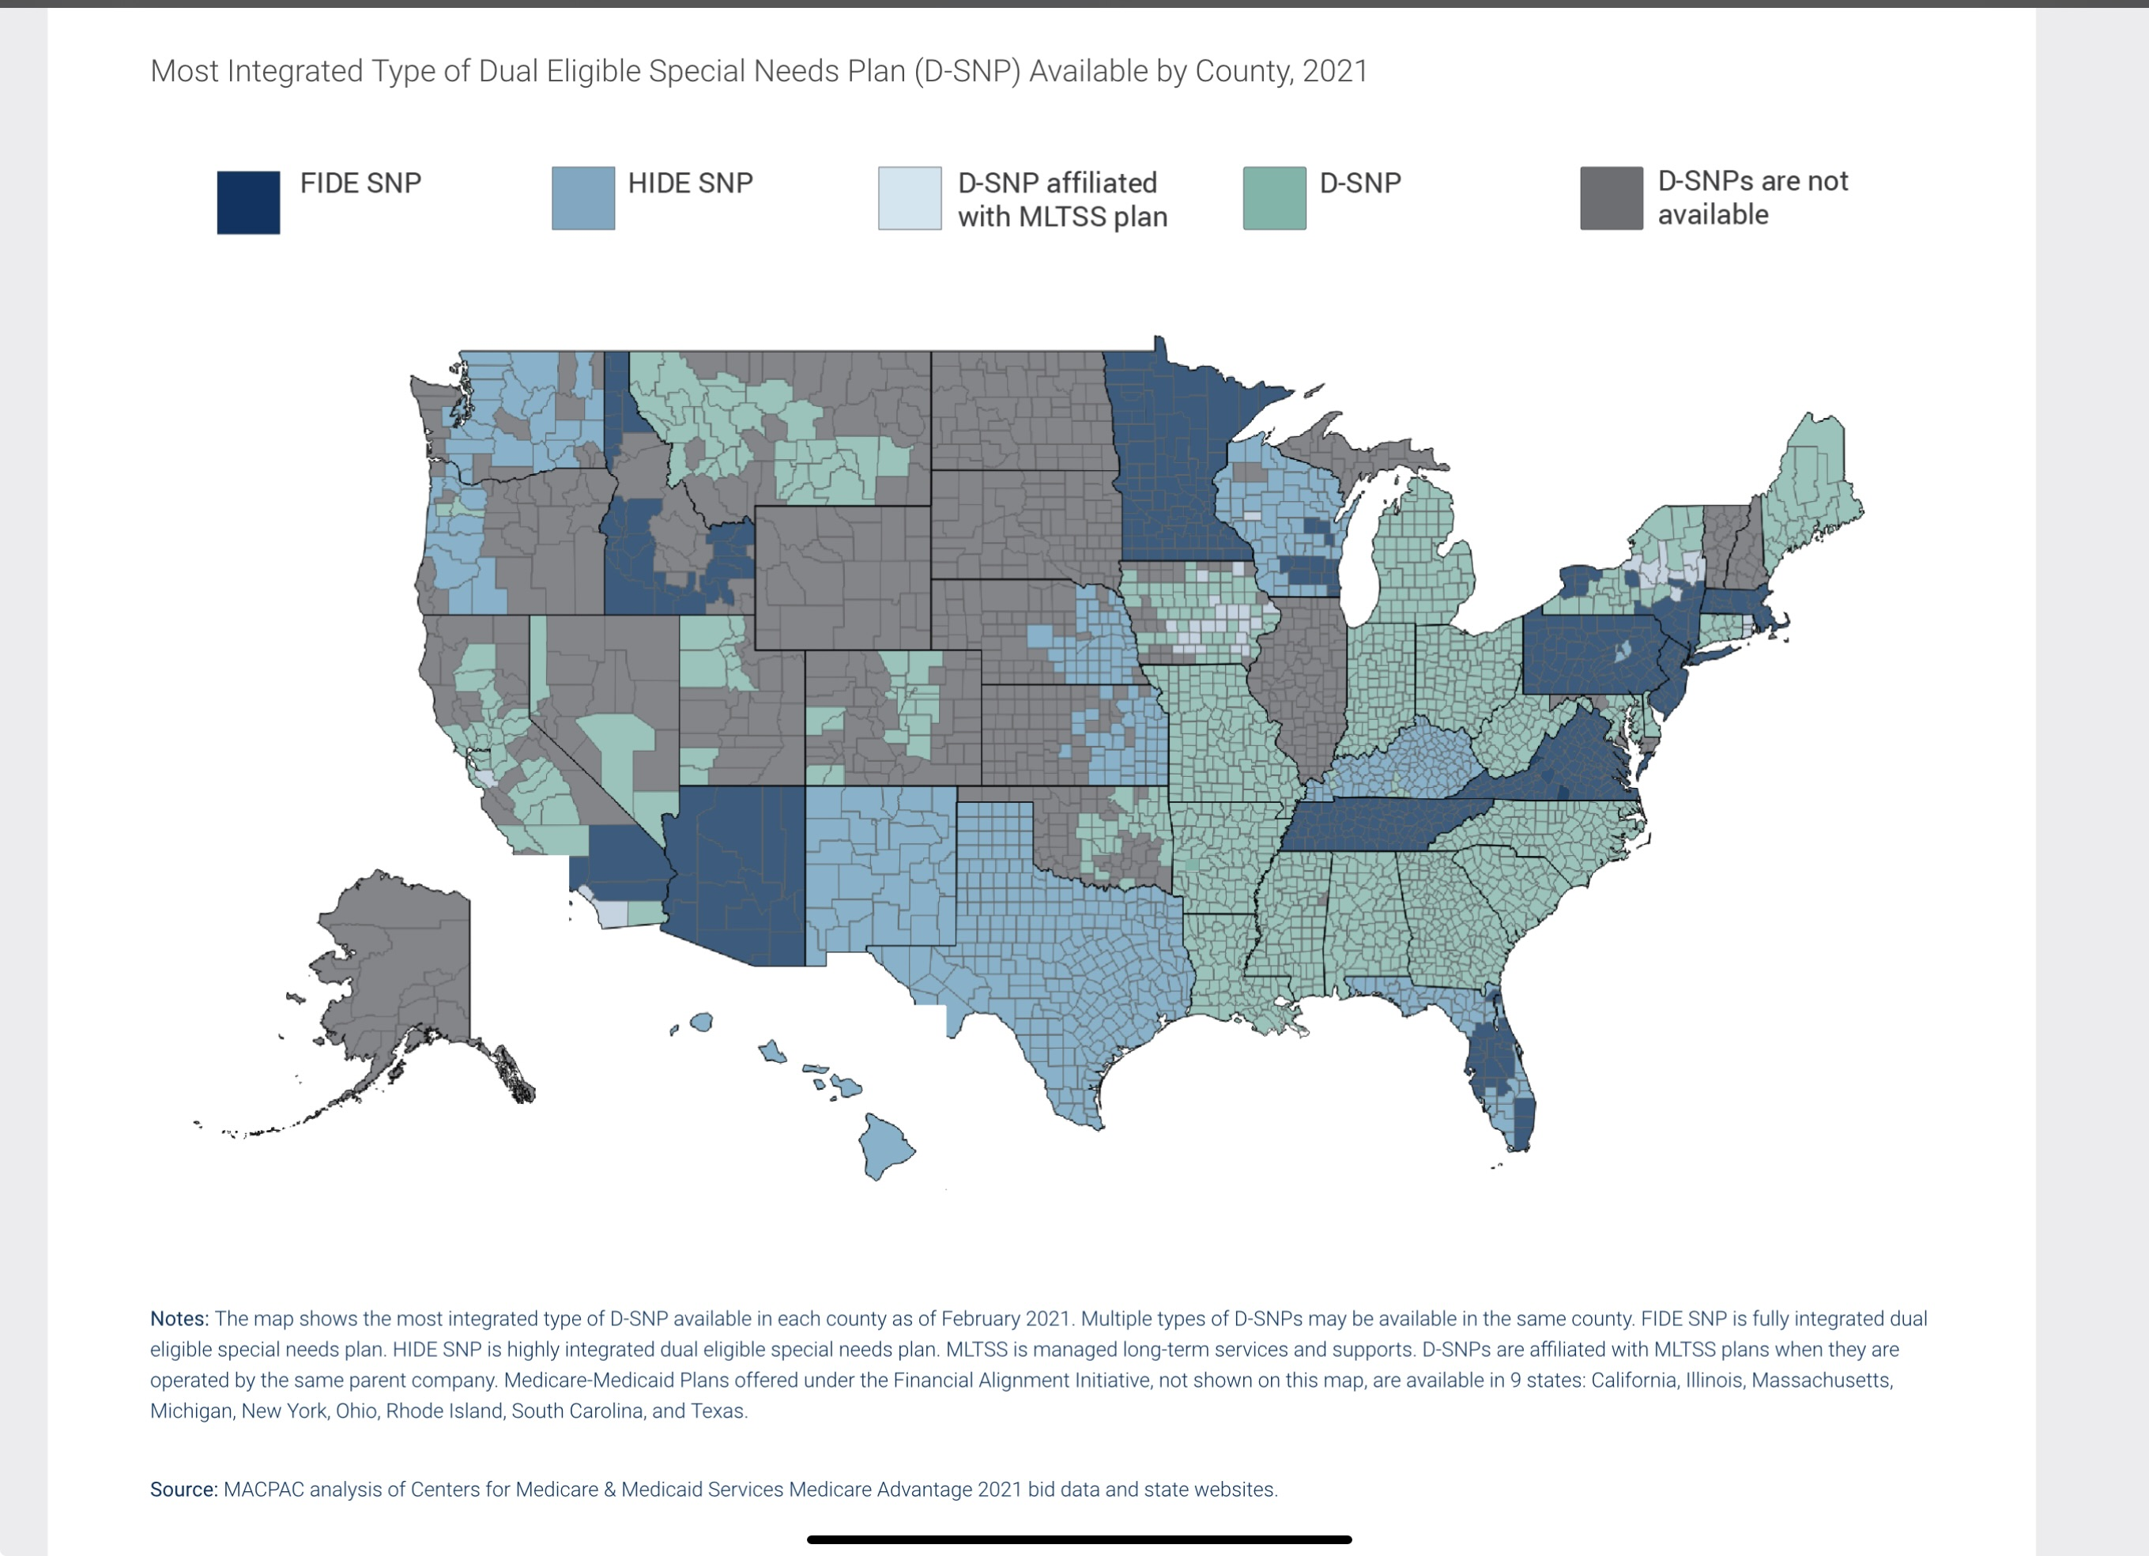
States That Use SMACs

Slide 25
Anticipating Dual Eligibility
Notes:
(request for ‘intros in chat’ for >6 and verbal intro for <6)

Slide 26

Triggers for Medicare Eligibility for Many People with I/DD
Death or retirement of a parent
The 24-month qualifying period after qualifying for SSDI
Qualifying by age or health condition (End stage renal disease (ESRD), breast cancer)
www.nasddds.org
26

Slide 27
Dual Eligibility Impacts
Enhanced access to a large network of other providers (pharmacy, medical, health care systems/hospitals, specialists, etc.)
Avoiding loss of benefits normally covered by Medicaid, and how to prepare providers (i.e., pharmacy)
Enhanced care coordination & other services beyond Medicaid
Individuals with I/DD and families should be made aware of the impacts having dual eligibility can bring, and how to navigate them
www.nasddds.org
27
Notes:
states should be anticipating these transitions in a manner consistent with other know-able life transitiosn. Using data on age of indiviual and, if available, age of caregiver, can provide a rough picture of individuals who could benefit from information and outreach on these transitions steps. emphasize importance of data and predictive analytics here...consider person-centered planning questions that can serve as information triggers for tools/information

Slide 28
Individual/Family Resources
Notes:
(request for ‘intros in chat’ for >6 and verbal intro for <6)

Slide 29

Opportunities To Help Individuals with I/DD and Families Prepare for and Understand the System
Development of information, or toolkits (with their input) to help people learn about programs/benefits available to them, and become aware of eligibility “triggers”
Understand and connect to trusted resources in their communities that they can turn to ask for assistance throughout their health care journey
www.nasddds.org
29
Notes:
Quick Bites that individuals and families can easily understand with basic information and inclusive of culturally appropriate materials
Over one-third of Medicaid beneficiaries who quality on the basis of a disability do so through receipt of Supplemental Security Income (SSI), the federal case assistance program for the elderly and people with disabilities who have low levels of income and assets

Slide 30
Keys to Connection for Individuals & Families: Supports Coordinators & Other Critical Providers
Supports Coordinators and other providers/organizations are critical “gatekeepers” of the system and a primary source of information for individuals with I/DD and their families
They often support individuals/families when Medicaid services are affected (or even lost) once an individual becomes dually eligible
They can help individuals and families establish critical linkages to educate communities and connect duals and their families to necessary supports
Other critical service providers, such as residential and options providers, can serve as a critical resource for individuals and families
www.nasddds.org
30

Slide 31
Other Critical Supports for Individuals & Families
Supports Coordinators and other providers/organizations are critical “gatekeepers” of the system and a primary source of information for individuals with I/DD and their families
They often support individuals/families when Medicaid services are affected (or even lost) once an individual becomes dually eligible
They are uniquely situated to establish critical linkages they can use to educate communities and connect duals and their families to necessary supports
Notes:
Creation of specialized training opportunities for support systems at state and local levels, including supports coordinators, benefits counselors, and residential providers
Expand their awareness and understanding of Medicare and Medicaid systems, and how they do/don’t integrate
Provide a roadmap for how to navigate benefits offered by both programs
Develop an understanding of dual eligible population needs and resources they can share with individuals who are already or who will become dually eligible
Provide access to educational materials and resources for continuous learning

Slide 32
Additional Resources for Individuals & Families (and States, too!)
Notes:
Reflect on how these resources also work for states as reviewed in the last training

Slide 33
Aging, Disability and Resource Centers (ADRC)
Aging and Disability Resource Centers (ADRCs) across the country seek to address the frustrations many older adults, people with disabilities, and family members experience when trying to learn about and access LTSS
They provide unbiased, reliable information & counseling to people with all levels of income
ADRCs help people:
Understand their service options
Provide objective information, advice, counseling and assistance
Empower people to make informed decisions about LTSS
Help people access public and private programs
ADRC system capacity varies with each state and can be found at www.eldercare.acl.gov
www.nasddds.org

Slide 34
The Social Security Administration (SSA)
People apply for Medicare benefits through the Social Security Administration (SSA)
https://www.ssa.gov/medicare/sign-up
The SSA has offices throughout the states and a website where individuals can turn to apply for Medicare benefits and answers to questions
The SSA also supports beneficiaries who are in the Medicare Fee For Service delivery system
Manage Benefits
File appeals
SSA Medicare Resource Page: https://www.benefits.gov/benefit/4394
www.nasddds.org

Slide 35

Introduction of the Office of Healthcare Information and Counseling: Help for Medicare Enrollees, Their Families, and Caregivers
Rebecca Kinney
Director, Office of Healthcare Information and Counseling
Administration for Community Living (ACL)
35

Slide 36
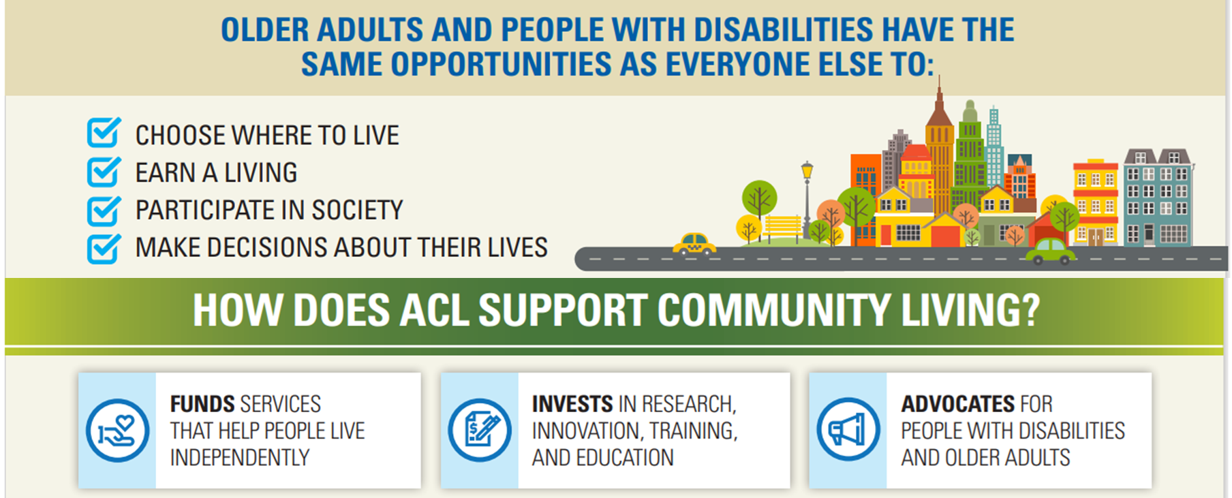
Administration for Community Living
36
Notes:
Mission: Maximize the independence, well-being, and health of older adults, people with disabilities across the lifespan, and their families and caregivers.
Vision: For all people, regardless of age and disability, to live with dignity, make their own choices, and participate fully in society.

Slide 37

Office of Healthcare Information and Counseling (OHIC)
OHIC manages the Medicare-related programs administered by ACL:
State Health Insurance Assistance Programs (SHIP)
Senior Medicare Patrol (SMP)
Medicare Improvements for Patients and Providers Act Program (MIPPA)
MIPPA State Grants
National Center for Benefits Outreach and Enrollment (NCBOE)
37

Slide 38
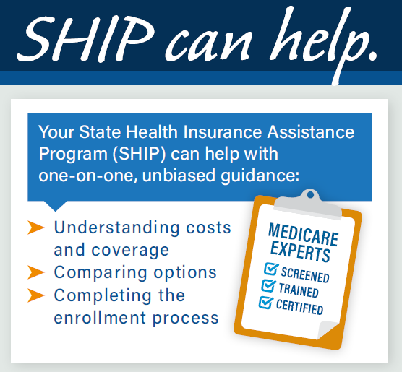

State Health Insurance Assistance Program (SHIP)
Mission:
To empower, educate, and assist Medicare-eligible individuals, their families, and caregivers through objective outreach, counseling, and training, to make informed health insurance decisions that optimize access to care and benefits.
38

Slide 39

SHIP Grantees
54 SHIPs
One in every state, Puerto Rico, Guam, DC, and US Virgin Islands
Operated through either the State Unit on Aging or the Dept. of Insurance
2,200 local programs
12,500 counselors
Approximately 50% are volunteers
4 million individuals educated
2.5 million counseling sessions

Slide 40
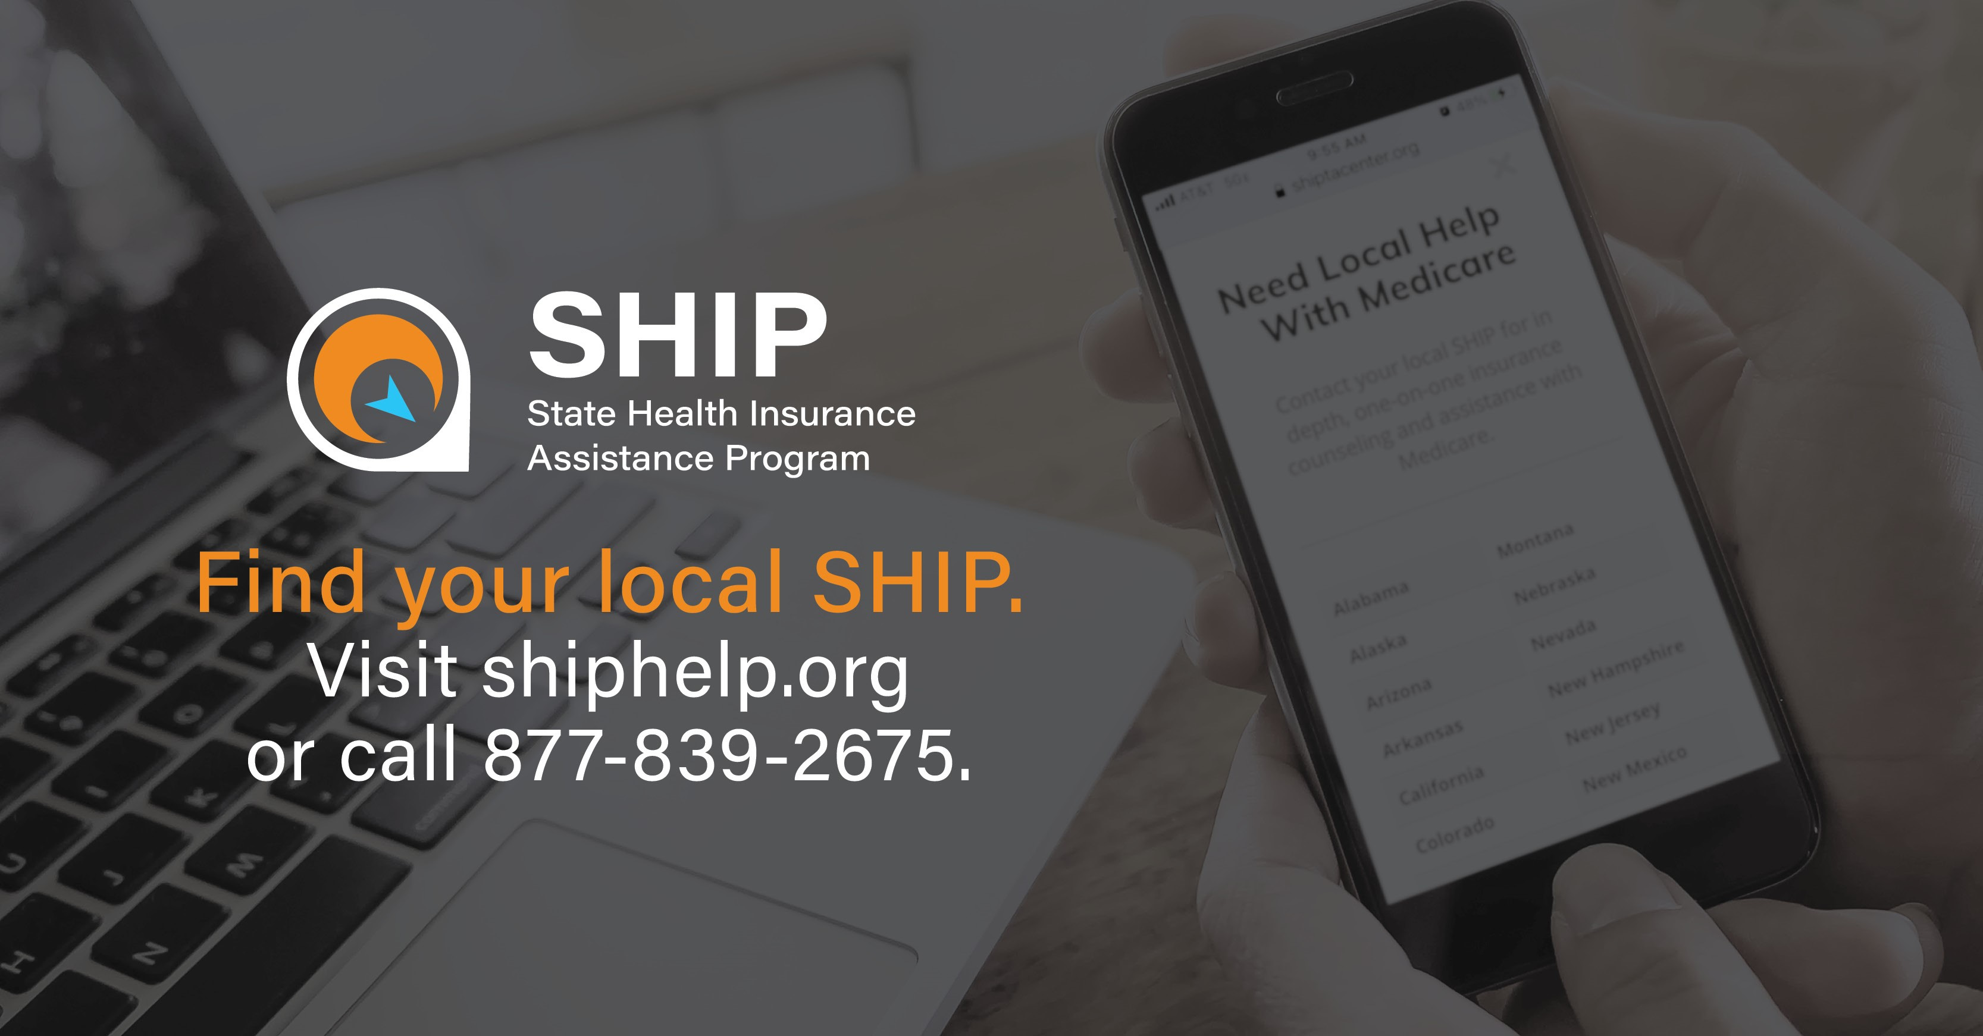
Find Your Local SHIP
40

Slide 41

Senior Medicare Patrol (SMP)
54 Grantees: 6,900 team members nationally serve in every state, DC, PR, GU, and USVI
SMP goals:
To prevent Medicare fraud before it happens via public outreach and one-on-one assistance and
To report suspected issues as quickly as possible to the proper investigators
SMP is known as a trusted OIG & CMS partner and provides a direct link from Medicare beneficiaries to fraud investigators
Example: OIG credits SMP with first notifying them of genetic testing schemes in 2019.
SMP Resource Center: SMPResource.org
Mission
To empower and assist Medicare beneficiaries, their families, and caregivers to prevent, detect, and report health care fraud, errors, and abuse through outreach, counseling, and education.
41

Slide 42

Find Your Local SMP
Visit:
SMPResource.org
or
877-808-2468
42

Slide 43
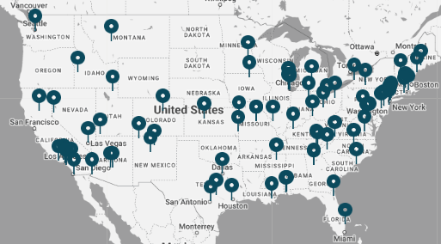
National Center for Benefits Outreach and Enrollment (NCBOE)
Cooperative agreement awarded to the National Council on Aging (NCOA) to:
Serve as the resource center for MIPPA grantees
Establish Benefits Enrollment Centers (BECs) to assist Medicare beneficiaries with limited income and assets to apply for Extra Help, Medicare Savings Program, SNAP, LIHEAP, etc
Promote BenefitsCheckUp screenings for a wide range of benefits
Maintain an online information clearinghouse of promising practices related to benefits outreach and enrollment
NOTE: Alaska and Hawaii BECs not pictured in map
43

Slide 44

Protection of Vulnerable Elders: Long-Term Care Ombudsman
Promote policies and consumer protections to improve LTSS including:
Monitoring conditions,
Investigating complaints,
Representing resident interests, and
Conducting site visits to facilities.
Ombudsman work to resolve problems related to the health, safety, welfare, and rights of individuals who live in:
Nursing homes,
Board and care and assisted living,
Other residential care communities, and
Some state integrated care models for non-residential services.
44
Notes:
Quarterly site visits:
63% of nursing homes;
26% of assisted living, board and care, and other facilities.
Ombudsman include:
1,301 professional ombudsman and 7,734 volunteers:

Slide 45

Getting Help from LTC Ombudsman
Individuals and families can reach out to an Ombudsman to receive assistance with:
Identifying, investigating and resolving complaints made by or on behalf of individuals
Receiving information about patient rights, government benefits and other assistance
Representing resident interests before governmental agencies & seek administrative, legal and other remedies to protect residents
Long-Term Care Ombudsman Programs in states can be found using the following link: www.consumervoice.org
45

Slide 46

Eldercare Locator
Connects older Americans and caregivers with trustworthy local resources such as information and connections to:
Meals,
Home care,
Elder rights,
Housing,
Insurance,
Transportation, and
Caregiver training and education.
Connects consumers to Area Agencies on Aging, Aging and Disability Resource Centers, and other Community-Based Organizations.
1-800-677-1116
46

Slide 47
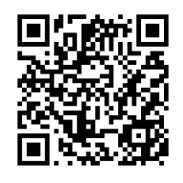
I/DD Dual Eligibility State Training Series
Previous Sessions:
Dual Eligibility Introduction
Medicare Basics
State Strategies to Support Systems Serving Dual Eligibles
State Roundtables
State DD AgencyTraining Series
Targeted Technical Assistance
State Toolkit & Policy Recommendations
NEW! NASDDDS Dual Eligibility Resource Page

Slide 48
Technical Assistance Opportunity
Notes:
(request for ‘intros in chat’ for >6 and verbal intro for <6)

Slide 49
I/DD Duals Innovation Cohort
Purpose: The I/DD Duals Innovation Cohort offers a twelve-month TA initiative to up to 6 competitively selected I/DD programs to design an implementation strategy to assure that individuals with I/DD who are dually eligible are appropriately identified and supported to receive Medicare- and Medicaid-funded benefits to the maximum extent possible. ​This is at no cost to states.
Activities:​
Onsite TA
Strategic Plan Development
Virtual TA ​
Information and Training Material Development
Applications Due June 3, 2024
MS Word
PDF

Slide 50
Questions? Teja Stokes – tstokes@nasddds.org Jeanine Zlockie – jzlockie@nasddds.org
Notes:
Talking Points on Next Steps

Slide 51
THANK YOU!
Notes:
Talking Points on Next Steps

Slide 52

Closing Slide
301 N Fairfax Street, Suite 101, Alexandria, VA 22314-2633 | Tel: 703-683-4202
www.nasddds.org | @NasdddsUs

